Slide 1
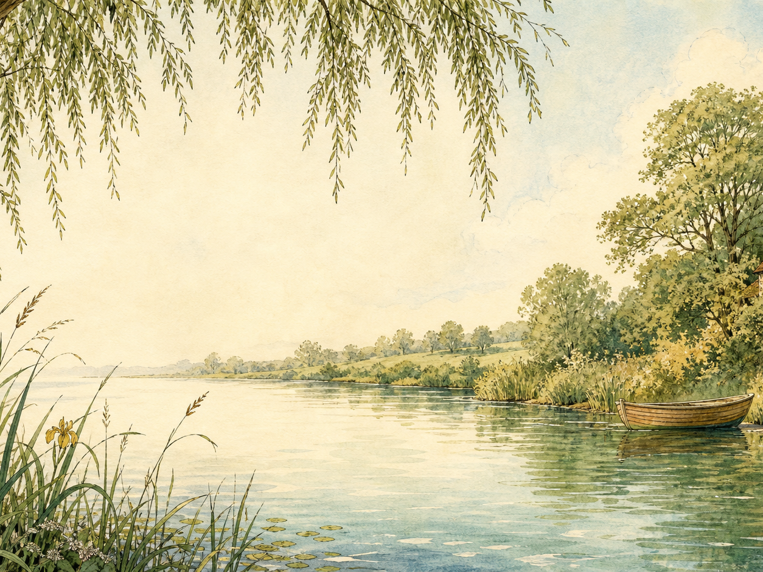
THE WIND IN THE WILLOWS
Independent Living Book Study

Slide 2
Symbol Meanings
Writing Journal
Access to the Internet
Nature Journal
The Wind in the Willows Novel
Book of Centuries
Art Journal
Geography Journal

Slide 3
Day 1 Tasks
DAY 01 / 15
What do I need today?
Read Ch 1: The River Bank
Narration: what makes the riverbank so appealing?
Nature: research riverbank wildlife
Colour in the box when completed

Slide 4
Day 2 Tasks
DAY 02 / 15
What do I need today?
Read Ch 2: The Open Road
Narration: what does Toad's caravan tell us about him?
History: the arrival of motor cars
Colour in the box when completed

Slide 5
Day 3 Tasks
DAY 03 / 15
What do I need today?
Read Ch 3: The Wild Wood
Writing: describe a frightening place
Discuss: how is fear built in this chapter?
Colour in the box when completed

Slide 6
Day 4 Tasks
DAY 04 / 15
What do I need today?
Read Ch 4: Mr Badger
Discuss: compare the animals' homes
Art: draw Badger's underground home
Colour in the box when completed

Slide 7
Day 5 Tasks
DAY 05 / 15
What do I need today?
Read Ch 5: Dulce Domum
Narration: why does Mole feel emotional going home?
Discuss: what makes somewhere feel like home?
Colour in the box when completed

Slide 8
Day 6 Tasks
DAY 06 / 15
What do I need today?
Read Ch 6: Mr Toad
Discuss: humour in Toad's speeches
Drama: perform a boastful Toad speech
Colour in the box when completed

Slide 9
Day 7 Tasks
DAY 07 / 15
What do I need today?
Read Ch 7: The Piper at the Gates of Dawn
Discuss: how this chapter feels different
Art: respond to the dawn river imagery
Colour in the box when completed

Slide 10
Day 8 Tasks
DAY 08 / 15
What do I need today?
Read Ch 8: Toad's Adventures
Narration: retell Toad's escape
Drama: act out the disguise scene
Colour in the box when completed

Slide 11
Day 9 Tasks
DAY 09 / 15
What do I need today?
Read Ch 9: Wayfarers All
Discuss: adventure vs. home
Geography: map the Sea Rat's travels
Colour in the box when completed

Slide 12
Day 10 Tasks
DAY 10 / 15
What do I need today?
Read Ch 10: The Further Adventures of Toad
Discuss: what keeps going wrong for Toad?
Narration: retell as a newspaper report
Colour in the box when completed

Slide 13
Day 11 Tasks
DAY 11 / 15
What do I need today?
Read Ch 11: 'Like Summer Tempests...'
Narration: what's happened to Toad Hall?
Discuss: is this fair on Toad?
Colour in the box when completed

Slide 14
Day 12 Tasks
DAY 12 / 15
What do I need today?
Read Ch 12: The Return of Ulysses
Discuss: has Toad really changed?
Compare: Toad's change to another reformed character
Colour in the box when completed

Slide 15
Day 13 Tasks
DAY 13 / 15
What do I need today?
Response day - review the whole book
Character profiles: Mole, Rat, Badger, Toad
Discuss: which character are you most like?
Colour in the box when completed

Slide 16
Day 14 Tasks
DAY 14 / 15
What do I need today?
Wrap-up: watch a film adaptation
Discuss: book vs. film
Art: explore E.H. Shepard's illustrations
Colour in the box when completed

Slide 17
Day 15 Tasks
DAY 15 / 15
What do I need today?
Wrap-up: it's your turn to write
Plan a new adventure for the four friends
Share your new chapter aloud
Colour in the box when completed

