Slide 1
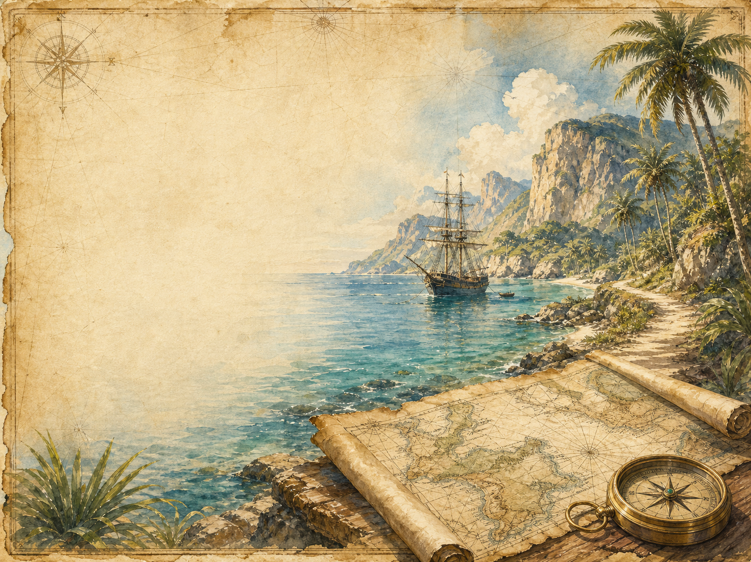
TREASURE ISLAND
Independent Living Book Study

Slide 2
Symbol Meanings
Writing Journal
Access to the Internet
History Journal
Treasure Island Novel
Book of Centuries
Art Journal
Character Study
Geography Journal

Slide 3
Day 1 Tasks
DAY 01 / 17
What do I need today?
Read Ch 1-2: The Old Sea-dog / Black Dog
Narration: what makes Billy Bones menacing?
History: coastal inns and smuggling
Colour in the box when completed

Slide 4
Day 2 Tasks
DAY 02 / 17
What do I need today?
Read Ch 3-4: The Black Spot / The Sea-chest
Discuss: the meaning of the black spot
Literacy: start a pirate vocabulary glossary
Colour in the box when completed

Slide 5
Day 3 Tasks
DAY 03 / 17
What do I need today?
Read Ch 5-6: The Last of the Blind Man
Narration: the death of Pew
Geography: study the treasure map
Colour in the box when completed

Slide 6
Day 4 Tasks
DAY 04 / 17
What do I need today?
Read Ch 7-8: I Go to Bristol / The Spy-glass
Discuss: first impressions of Silver
Start your Silver character study
Colour in the box when completed

Slide 7
Day 5 Tasks
DAY 05 / 17
What do I need today?
Read Ch 9-10: Powder and Arms / The Voyage
Science: 18th-century sailing ships
Narration: life aboard the Hispaniola
Colour in the box when completed

Slide 8
Day 6 Tasks
DAY 06 / 17
What do I need today?
Read Ch 11-12: The Apple-Barrel / Council of War
Discuss: how tension is built
Writing: Jim's thoughts in the barrel
Colour in the box when completed

Slide 9
Day 7 Tasks
DAY 07 / 17
What do I need today?
Read Ch 13-14: Shore Adventure / The First Blow
Narration: Jim's first sight of the island
Discuss: how violence is handled
Colour in the box when completed

Slide 10
Day 8 Tasks
DAY 08 / 17
What do I need today?
Read Ch 15: The Man of the Island
Discuss: Ben Gunn and being marooned
Art: draw Ben Gunn
Colour in the box when completed

Slide 11
Day 9 Tasks
DAY 09 / 17
What do I need today?
Read Ch 16-17: The Doctor's Narrative
Discuss: why the narrator switches
Compare Dr Livesey's voice to Jim's
Colour in the box when completed

Slide 12
Day 10 Tasks
DAY 10 / 17
What do I need today?
Read Ch 18-19: End of Fighting / The Garrison
Narration: summarise the fighting
Discuss: Captain Smollett's leadership
Colour in the box when completed

Slide 13
Day 11 Tasks
DAY 11 / 17
What do I need today?
Read Ch 20-21: Silver's Embassy / The Attack
Drama: perform the negotiation
Discuss: what this reveals about Silver
Colour in the box when completed

Slide 14
Day 12 Tasks
DAY 12 / 17
What do I need today?
Read Ch 22-23: Sea Adventure / The Ebb-tide
Science: tides and small boats
Narration: Jim's coracle and his plan
Colour in the box when completed

Slide 15
Day 13 Tasks
DAY 13 / 17
What do I need today?
Read Ch 24-25: The Coracle / Jolly Roger
Narration: retell Jim's solo adventure
Discuss: why Jim takes such risks
Colour in the box when completed

Slide 16
Day 14 Tasks
DAY 14 / 17
What do I need today?
Read Ch 26-27: Israel Hands / Pieces of Eight
Discuss: how suspense is built
Extension: pace and sentence length
Colour in the box when completed

Slide 17
Day 15 Tasks
DAY 15 / 17
What do I need today?
Read Ch 28-29: Enemy's Camp / Black Spot Again
Discuss: why Jim returns to the stockade
Update your Silver character study
Colour in the box when completed

Slide 18
Day 16 Tasks
DAY 16 / 17
What do I need today?
Read Ch 30-31: On Parole / Flint's Pointer
Geography: follow the treasure hunt
Discuss: Silver switching sides again
Colour in the box when completed

Slide 19
Day 17 Tasks
DAY 17 / 17
What do I need today?
Read Ch 32-34: Voice Among the Trees / And Last
Discuss: Silver's fate - deserved?
Wrap-up: who is punished, who is rewarded?
Colour in the box when completed

