Slide 1
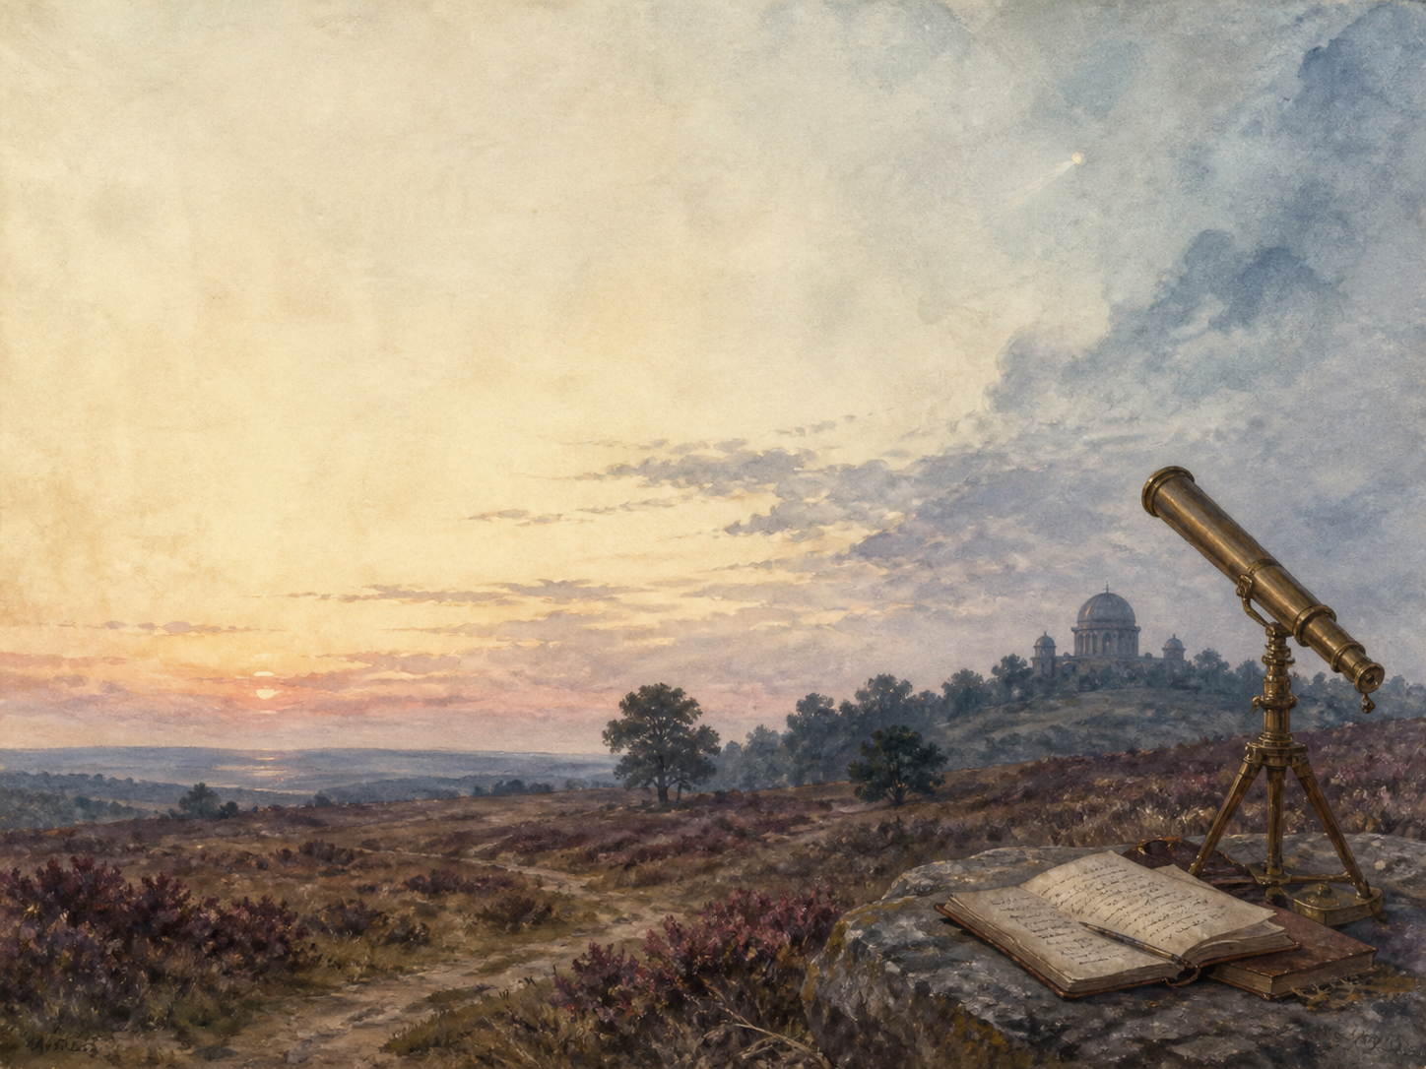
THE WAR OF THE WORLDS
Independent Living Book Study

Slide 2
Symbol Meanings
Reading Journal
Access to the Internet
History Journal
War of the Worlds Novel
Book of Centuries
Art Journal
Science Notes
Geography / Map

Slide 3
Day 1 Tasks
DAY 01 / 14
What do I need today?
Read Bk1 I-II: The Falling Star
Narration: how it all begins
Science: the planet Mars
Colour in the box when completed

Slide 4
Day 2 Tasks
DAY 02 / 14
What do I need today?
Read Bk1 III-IV: The Cylinder Opens
Narration: the first Martian
Discuss: why no one sees the danger
Colour in the box when completed

Slide 5
Day 3 Tasks
DAY 03 / 14
What do I need today?
Read Bk1 V-VI: The Heat-Ray
Narration: the flag of truce
Science: how a laser works
Colour in the box when completed

Slide 6
Day 4 Tasks
DAY 04 / 14
What do I need today?
Read Bk1 VII-VIII: Friday Night
Discuss: dread in the quiet
Geography: map the invasion
Colour in the box when completed

Slide 7
Day 5 Tasks
DAY 05 / 14
What do I need today?
Read Bk1 IX-X: The Fighting Begins
Narration: the machines rise
Art: illustrate a tripod
Colour in the box when completed

Slide 8
Day 6 Tasks
DAY 06 / 14
What do I need today?
Read Bk1 XI-XII: Destruction
Discuss: a costly rare victory
Science: invasive species (red weed)
Colour in the box when completed

Slide 9
Day 7 Tasks
DAY 07 / 14
What do I need today?
Read Bk1 XIII-XIV: The Curate; In London
Narration: London begins to panic
PSHE: first reactions to danger
Colour in the box when completed

Slide 10
Day 8 Tasks
DAY 08 / 14
What do I need today?
Read Bk1 XV-XVI: The Exodus
Narration: the Black Smoke and the flight
History: real mass evacuations
Colour in the box when completed

Slide 11
Day 9 Tasks
DAY 09 / 14
What do I need today?
Read Bk1 XVII + Bk2 I-II: Thunder Child
Narration: the ironclad's charge
Discuss: the mood shifts for Book Two
Colour in the box when completed

Slide 12
Day 10 Tasks
DAY 10 / 14
What do I need today?
Read Bk2 III-IV: Death of the Curate
Discuss: what fear does to people
PSHE: stress and behaviour
Colour in the box when completed

Slide 13
Day 11 Tasks
DAY 11 / 14
What do I need today?
Read Bk2 V-VI: The Stillness
Narration: the weed-covered land
Science: how ecosystems recover
Colour in the box when completed

Slide 14
Day 12 Tasks
DAY 12 / 14
What do I need today?
Read Bk2 VII: The Man on Putney Hill
Discuss: the artilleryman's plan
Drama: perform his speech
Colour in the box when completed

Slide 15
Day 13 Tasks
DAY 13 / 14
What do I need today?
Read Bk2 VIII: Dead London
Narration: the great discovery
Science: germs and immunity
Colour in the box when completed

Slide 16
Day 14 Tasks
DAY 14 / 14
What do I need today?
Read Bk2 IX-X: The Epilogue
Wrap-up: recovery and the lesson
Extension: the invasion as a mirror to empire
Colour in the box when completed

