Slide 1
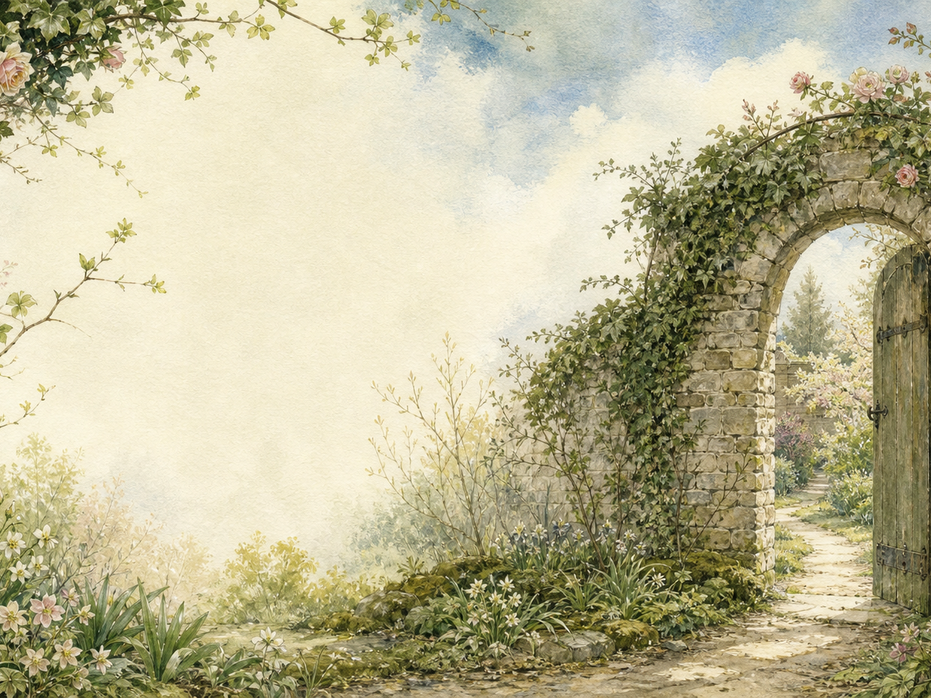
THE SECRET GARDEN
Independent Living Book Study

Slide 2
Symbol Meanings
Writing Journal
Access to the Internet
Nature Journal
The Secret Garden Novel
Book of Centuries
Art Journal
Growth Diary

Slide 3
Day 1 Tasks
DAY 01 / 15
What do I need today?
Read Ch 1-2: There Is No One Left / Mistress Mary
Narration: what kind of child is Mary?
History: colonial India in the early 1900s
Colour in the box when completed

Slide 4
Day 2 Tasks
DAY 02 / 15
What do I need today?
Read Ch 3-4: Across the Moor / Martha
Word bank: Yorkshire dialect words
Geography: map India to Yorkshire
Colour in the box when completed

Slide 5
Day 3 Tasks
DAY 03 / 15
What do I need today?
Read Ch 5-6: The Cry in the Corridor
Discuss: how is mystery built here?
Predict: who is crying?
Colour in the box when completed

Slide 6
Day 4 Tasks
DAY 04 / 15
What do I need today?
Read Ch 7-8: The Key / The Robin
Discuss: what do the key and robin represent?
Nature: research robins
Colour in the box when completed

Slide 7
Day 5 Tasks
DAY 05 / 15
What do I need today?
Read Ch 9: The Strangest House
Narration: describe Misselthwaite Manor
Art: draw the house
Colour in the box when completed

Slide 8
Day 6 Tasks
DAY 06 / 15
What do I need today?
Read Ch 10-11: Dickon / The Missel Thrush
Discuss: what makes Dickon special?
Art: draw Dickon and his animals
Colour in the box when completed

Slide 9
Day 7 Tasks
DAY 07 / 15
What do I need today?
Read Ch 12: 'Might I Have a Bit of Earth?'
Discuss: why this moment matters for Mary
Nature: plant a bulb or seed
Colour in the box when completed

Slide 10
Day 8 Tasks
DAY 08 / 15
What do I need today?
Read Ch 13-14: 'I Am Colin' / A Young Rajah
Discuss: compare Colin to early Mary
History: discuss the 'Young Rajah' nickname
Colour in the box when completed

Slide 11
Day 9 Tasks
DAY 09 / 15
What do I need today?
Read Ch 15: Nest Building
Narration: how Mary changes Colin's outlook
Writing: Mary and Colin's conversation
Colour in the box when completed

Slide 12
Day 10 Tasks
DAY 10 / 15
What do I need today?
Read Ch 16-17: 'I Won't!' / A Tantrum
Discuss: why Mary's reaction matters
Drama: act out the tantrum
Colour in the box when completed

Slide 13
Day 11 Tasks
DAY 11 / 15
What do I need today?
Read Ch 18-19: 'Tha' Munnot Waste No Time'
Nature: spring growth in the garden
Discuss: how Dickon helps Colin
Colour in the box when completed

Slide 14
Day 12 Tasks
DAY 12 / 15
What do I need today?
Read Ch 20: 'I Shall Live Forever'
Narration: Colin sees the garden
Art: illustrate this moment
Colour in the box when completed

Slide 15
Day 13 Tasks
DAY 13 / 15
What do I need today?
Read Ch 21-22: Ben Weatherstaff
Discuss: why Ben cares about the garden
Narration: retell from Ben's view
Colour in the box when completed

Slide 16
Day 14 Tasks
DAY 14 / 15
What do I need today?
Read Ch 23-24: Magic / 'Let Them Laugh'
Discuss: what does 'Magic' mean here?
PSHE: try your own daily 'Magic'
Colour in the box when completed

Slide 17
Day 15 Tasks
DAY 15 / 15
What do I need today?
Read Ch 25-27: The Curtain / In the Garden
Narration: how has the household changed?
Wrap-up: compare start and end
Colour in the box when completed

