Slide 1
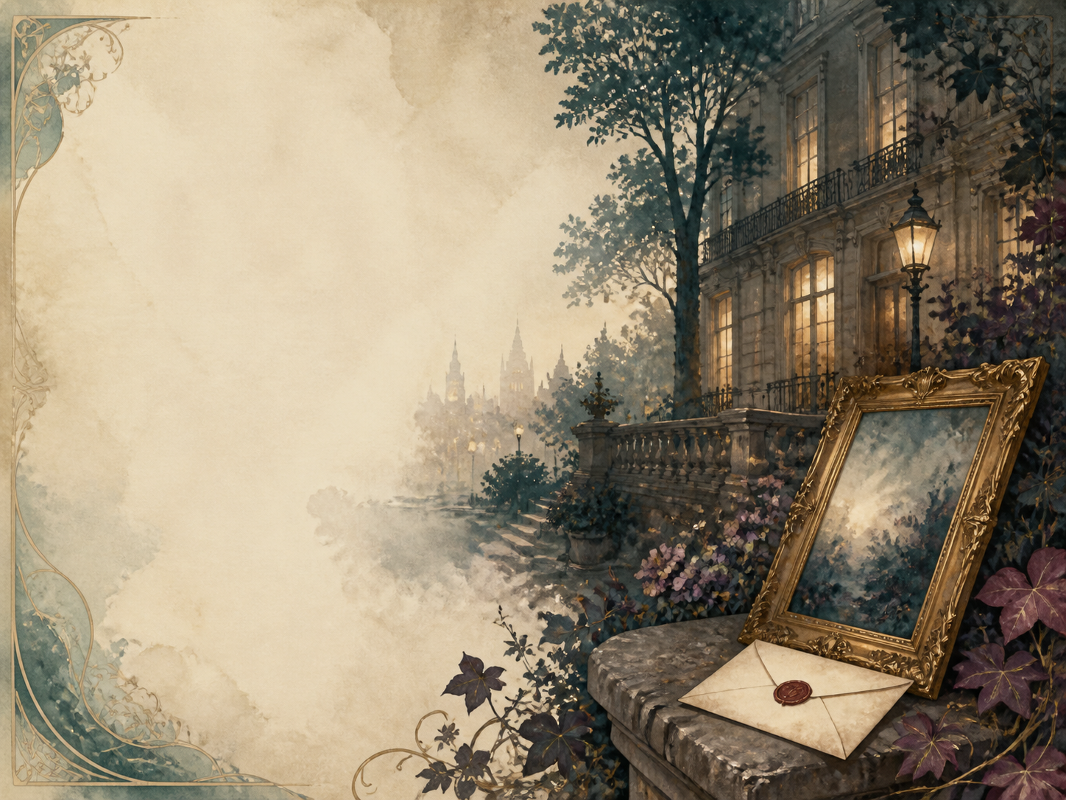
THE PICTURE OF
DORIAN GRAY
Independent Living Book Study

Slide 2
Symbol Meanings
Reading Journal
Access to the Internet
History Journal
Dorian Gray Novel
Book of Centuries
Art Journal
Portrait / Symbol Notes
Epigram Collection

Slide 3
Day 1 Tasks
DAY 01 / 14
What do I need today?
Read Preface + Ch 1
Discuss: the Preface; the three men
Art: what a portrait captures
Colour in the box when completed

Slide 4
Day 2 Tasks
DAY 02 / 14
What do I need today?
Read Ch 2: The Wish
Narration: Dorian's fateful wish
Discuss: why the wish is dangerous
Colour in the box when completed

Slide 5
Day 3 Tasks
DAY 03 / 14
What do I need today?
Read Ch 3-4: Influence and Love
Discuss: Lord Henry's growing grip
PSHE: shaped by those we admire
Colour in the box when completed

Slide 6
Day 4 Tasks
DAY 04 / 14
What do I need today?
Read Ch 5: Sibyl's Family
Narration: Sibyl, her mother, James
Literacy: making us care for Sibyl
Colour in the box when completed

Slide 7
Day 5 Tasks
DAY 05 / 14
What do I need today?
Read Ch 6-7: The First Cruelty
Narration: rejecting Sibyl; the change
Discuss: is his cruelty forgivable?
Colour in the box when completed

Slide 8
Day 6 Tasks
DAY 06 / 14
What do I need today?
Read Ch 8: A Hardened Heart
Discuss: silencing his conscience
RE/PSHE: training away guilt
Colour in the box when completed

Slide 9
Day 7 Tasks
DAY 07 / 14
What do I need today?
Read Ch 9-10: The Portrait Hidden
Narration: hiding the portrait
Literacy: a book that 'infects'
Colour in the box when completed

Slide 10
Day 8 Tasks
DAY 08 / 14
What do I need today?
Read Ch 11: Years of Sin
Discuss: showing sin without spelling it out
History: Victorian hypocrisy
Colour in the box when completed

Slide 11
Day 9 Tasks
DAY 09 / 14
What do I need today?
Read Ch 12-13: Murder
Narration: the confrontation with Basil
Discuss: the turning point
Colour in the box when completed

Slide 12
Day 10 Tasks
DAY 10 / 14
What do I need today?
Read Ch 14: Covering the Crime
Discuss: one crime forces another
PSHE: trapped by wrongdoing
Colour in the box when completed

Slide 13
Day 11 Tasks
DAY 11 / 14
What do I need today?
Read Ch 15-16: The Opium Den
Narration: the den; James recognises him
Science: opium and addiction
Colour in the box when completed

Slide 14
Day 12 Tasks
DAY 12 / 14
What do I need today?
Read Ch 17-18: The Hunter Killed
Discuss: lucky, or doom closing in?
Literacy: the sense of dread
Colour in the box when completed

Slide 15
Day 13 Tasks
DAY 13 / 14
What do I need today?
Read Ch 19: A False Reform
Discuss: can Dorian truly reform?
RE/PSHE: good deeds, wrong reasons
Colour in the box when completed

Slide 16
Day 14 Tasks
DAY 14 / 14
What do I need today?
Read Ch 20: The Reckoning
Wrap-up: the fitting ending
Extension: the portrait as conscience
Colour in the box when completed

