Slide 1
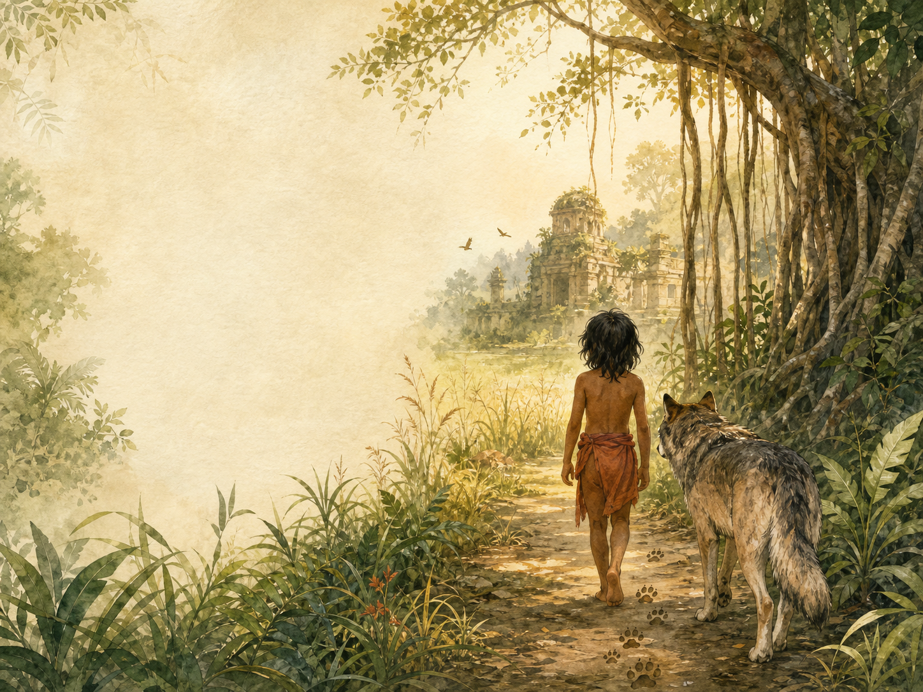
THE JUNGLE BOOK
Independent Living Book Study

Slide 2
Symbol Meanings
Writing Journal
Access to the Internet
History Journal
The Jungle Book
Book of Centuries
Art Journal
Law of the Jungle List

Slide 3
Day 1 Tasks
DAY 01 / 15
What do I need today?
Read Mowgli's Brothers + Hunting-Song
Narration: Mowgli joins the wolf pack
Poetry: read the Hunting-Song aloud
Colour in the box when completed

Slide 4
Day 2 Tasks
DAY 02 / 15
What do I need today?
Read Kaa's Hunting + Road-Song
Discuss: why the Bandar-log are outcasts
Poetry: compare tone to the Law of the Jungle
Colour in the box when completed

Slide 5
Day 3 Tasks
DAY 03 / 15
What do I need today?
Read 'Tiger! Tiger!' + Mowgli's Song
Discuss: Mowgli's return to the village
Writing: Mowgli's feelings on leaving
Colour in the box when completed

Slide 6
Day 4 Tasks
DAY 04 / 15
What do I need today?
Response day - the Mowgli trilogy
List: every Law of the Jungle rule so far
History: real wolf pack behaviour
Colour in the box when completed

Slide 7
Day 5 Tasks
DAY 05 / 15
What do I need today?
Read The White Seal (first half)
Narration: how Kotick is different
Geography: Bering Sea seal colonies
Colour in the box when completed

Slide 8
Day 6 Tasks
DAY 06 / 15
What do I need today?
Read The White Seal (second half) + Lukannon
Discuss: Kotick as a different kind of hero
Science: fur seal hunting history
Colour in the box when completed

Slide 9
Day 7 Tasks
DAY 07 / 15
What do I need today?
Read Rikki-Tikki-Tavi (first half)
Narration: Rikki-Tikki's character and courage
Science: mongooses and snakes
Colour in the box when completed

Slide 10
Day 8 Tasks
DAY 08 / 15
What do I need today?
Read Rikki-Tikki-Tavi (second half) + Darzee's Chant
Discuss: tension in the final fight
Discuss: the colonial household setting
Colour in the box when completed

Slide 11
Day 9 Tasks
DAY 09 / 15
What do I need today?
Read Toomai of the Elephants (first half)
History: elephants in colonial India
Discuss: Toomai's impossible dream
Colour in the box when completed

Slide 12
Day 10 Tasks
DAY 10 / 15
What do I need today?
Read Toomai (second half) + Shiv and the Grasshopper
Narration: the secret elephant dance
Art: illustrate the elephant dance
Colour in the box when completed

Slide 13
Day 11 Tasks
DAY 11 / 15
What do I need today?
Read Her Majesty's Servants
Discuss: camp animals on the eve of battle
History: animals in the British Indian Army
Colour in the box when completed

Slide 14
Day 12 Tasks
DAY 12 / 15
What do I need today?
Read Parade Song of the Camp Animals
Poetry: read aloud, animal by animal
Discuss: how the tone differs from Mowgli
Colour in the box when completed

Slide 15
Day 13 Tasks
DAY 13 / 15
What do I need today?
Response day - all seven stories
Compare stories in a table
Discuss: your favourite story, and why
Colour in the box when completed

Slide 16
Day 14 Tasks
DAY 14 / 15
What do I need today?
Extension day - Kipling's life and context
Research Kipling and colonial India
Book of Centuries: record key dates
Colour in the box when completed

Slide 17
Day 15 Tasks
DAY 15 / 15
What do I need today?
Wrap-up - it's your turn to write
Write your own story or 'law'
Share your writing aloud
Colour in the box when completed

