Slide 1
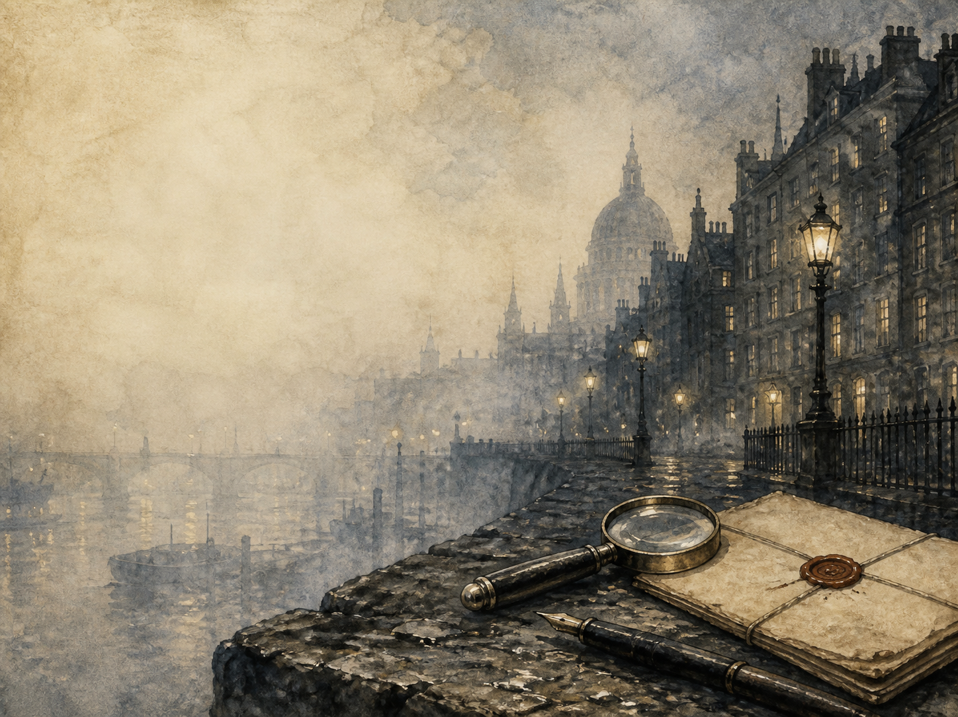
THE ADVENTURES OF
SHERLOCK HOLMES
Independent Living Book Study

Slide 2
Symbol Meanings
Case Journal
Access to the Internet
History Journal
Sherlock Holmes Stories
Book of Centuries
Art Journal
Deduction Notes
Geography / Map

Slide 3
Case 1
DAY 01 / 12
What do I need today?
Read: A Scandal in Bohemia
Narration: how Irene Adler outwits Holmes
Discuss: why she is always 'the woman'
Colour in the box when completed

Slide 4
Case 2
DAY 02 / 12
What do I need today?
Read: The Red-Headed League
Discuss: the clues in an absurd job
Literacy: what makes a fair puzzle?
Colour in the box when completed

Slide 5
Case 3
DAY 03 / 12
What do I need today?
Read: A Case of Identity
Discuss: reading tiny details
Science: try close observation
Colour in the box when completed

Slide 6
Case 4
DAY 04 / 12
What do I need today?
Read: The Boscombe Valley Mystery
Narration: clearing the accused man
PSHE: jumping to conclusions
Colour in the box when completed

Slide 7
Case 5
DAY 05 / 12
What do I need today?
Read: The Five Orange Pips
History: secret societies / the KKK
Discuss: a case Holmes doesn't fully win
Colour in the box when completed

Slide 8
Case 6
DAY 06 / 12
What do I need today?
Read: The Man with the Twisted Lip
Discuss: the beggar-gentleman
History: hidden Victorian London
Colour in the box when completed

Slide 9
Case 7
DAY 07 / 12
What do I need today?
Read: The Blue Carbuncle
Narration: the hat, the goose, the jewel
PSHE: was mercy the right choice?
Colour in the box when completed

Slide 10
Case 8
DAY 08 / 12
What do I need today?
Read: The Speckled Band
Discuss: the locked-room solution
Science: whistle, milk and the 'band'
Colour in the box when completed

Slide 11
Case 9
DAY 09 / 12
What do I need today?
Read: The Engineer's Thumb
Narration: the engineer's night of terror
Discuss: why this case is unusual
Colour in the box when completed

Slide 12
Case 10
DAY 10 / 12
What do I need today?
Read: The Noble Bachelor
Discuss: the vanishing bride
History: Victorian marriage and class
Colour in the box when completed

Slide 13
Case 11
DAY 11 / 12
What do I need today?
Read: The Beryl Coronet
Discuss: how appearances deceive
PSHE: trust within a family
Colour in the box when completed

Slide 14
Case 12
DAY 12 / 12
What do I need today?
Read: The Copper Beeches
Narration: the strange household
Wrap-up: why Holmes endures
Colour in the box when completed

