Slide 1
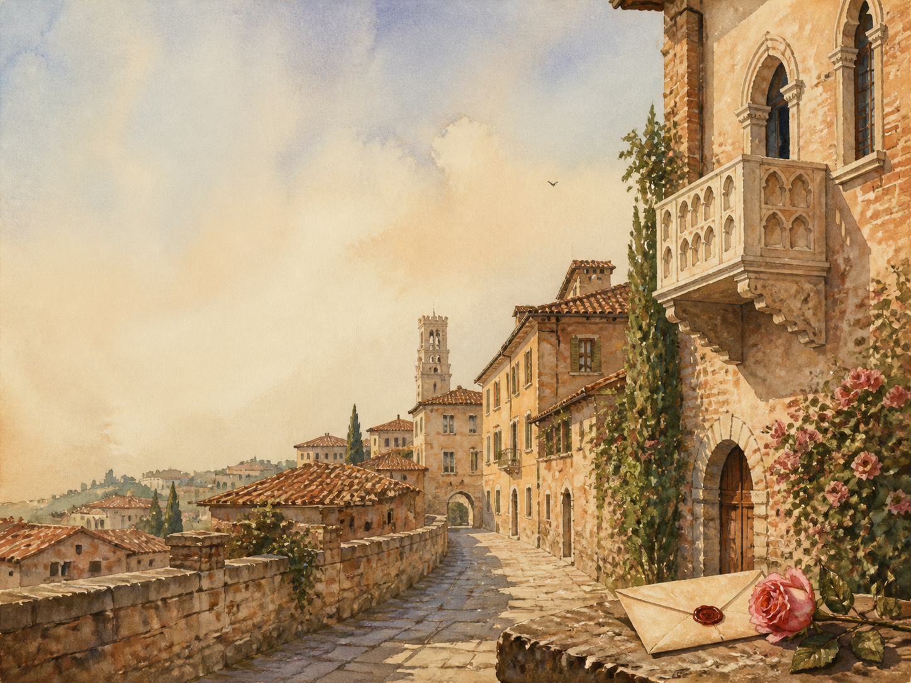
ROMEO AND JULIET
Independent Living Book Study

Slide 2
Symbol Meanings
Reading Journal
Access to the Internet
History Journal
The Play (Romeo and Juliet)
Book of Centuries
Art Journal
Quotation Bank
Watch a Film Version

Slide 3
Day 1
DAY 01 / 14
Read / watch this scene:
Prologue + Act 1 Sc 1
Narration: the feud and lovesick Romeo
Literacy: why reveal the ending?
Colour in the box when completed

Slide 4
Day 2
DAY 02 / 14
Read / watch this scene:
Act 1 Sc 2-3
Discuss: Juliet's say in marriage
History: daughters and marriage
Colour in the box when completed

Slide 5
Day 3
DAY 03 / 14
Read / watch this scene:
Act 1 Sc 4-5
Drama: the lovers' shared sonnet
Discuss: love at first sight?
Colour in the box when completed

Slide 6
Day 4
DAY 04 / 14
Read / watch this scene:
Act 2 Chorus + Sc 1-2
Drama: perform the balcony scene
Literacy: light and dark imagery
Colour in the box when completed

Slide 7
Day 5
DAY 05 / 14
Read / watch this scene:
Act 2 Sc 3-4
Discuss: is the Friar wise or reckless?
Drama: Mercutio's banter
Colour in the box when completed

Slide 8
Day 6
DAY 06 / 14
Read / watch this scene:
Act 2 Sc 5-6
Narration: the secret marriage
PSHE: love vs infatuation
Colour in the box when completed

Slide 9
Day 7
DAY 07 / 14
Read / watch this scene:
Act 3 Sc 1
Narration: the fatal duel
Discuss: who is to blame?
Colour in the box when completed

Slide 10
Day 8
DAY 08 / 14
Read / watch this scene:
Act 3 Sc 2-3
Discuss: their different reactions
Drama: Juliet waiting for night
Colour in the box when completed

Slide 11
Day 9
DAY 09 / 14
Read / watch this scene:
Act 3 Sc 4-5
Narration: the dawn parting; the clash
PSHE: Juliet vs her parents
Colour in the box when completed

Slide 12
Day 10
DAY 10 / 14
Read / watch this scene:
Act 4 Sc 1-2
Narration: the Friar's potion plan
Science: what a 'sleeping draught' was
Colour in the box when completed

Slide 13
Day 11
DAY 11 / 14
Read / watch this scene:
Act 4 Sc 3-5
Drama: Juliet's soliloquy before drinking
Discuss: her fear and loneliness
Colour in the box when completed

Slide 14
Day 12
DAY 12 / 14
Read / watch this scene:
Act 5 Sc 1
Discuss: news that arrives wrong
Literacy: the failed message
Colour in the box when completed

Slide 15
Day 13
DAY 13 / 14
Read / watch this scene:
Act 5 Sc 2
Narration: why the plan falls apart
History: the plague delays the letter
Colour in the box when completed

Slide 16
Day 14
DAY 14 / 14
Read / watch this scene:
Act 5 Sc 3
Wrap-up: the tomb and the peace
Extension: fate or human choice?
Colour in the box when completed

