Slide 1
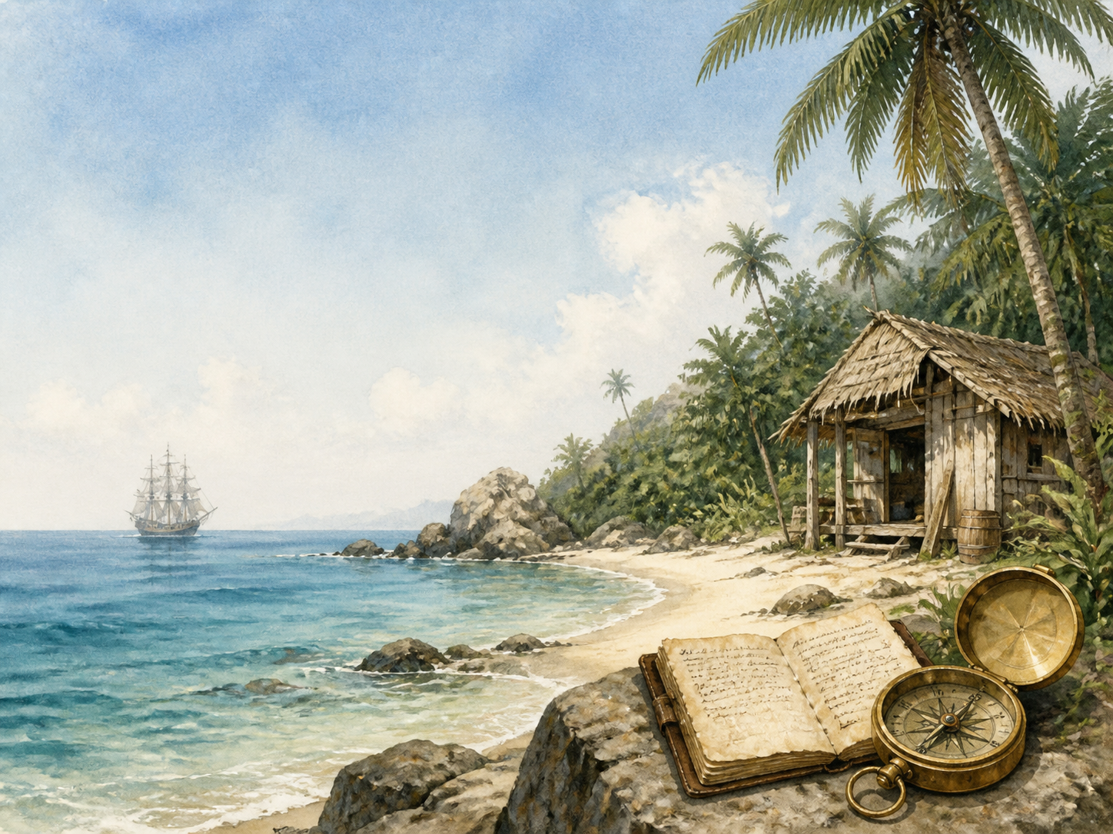
ROBINSON CRUSOE
Independent Living Book Study

Slide 2
Symbol Meanings
Writing Journal
Access to the Internet
History Journal
Robinson Crusoe Novel
Book of Centuries
Art Journal
Castaway Journal
Geography/Voyages Map

Slide 3
Day 1 Tasks
DAY 01 / 20
What do I need today?
Read Ch 1: Start in Life
Narration: the father's warning
Discuss: disobedience and consequence
Colour in the box when completed

Slide 4
Day 2 Tasks
DAY 02 / 20
What do I need today?
Read Ch 2: Slavery and Escape
History: Barbary pirates and slavery
Discuss: Crusoe selling Xury
Colour in the box when completed

Slide 5
Day 3 Tasks
DAY 03 / 20
What do I need today?
Read Ch 3: Wrecked on a Desert Island
Discuss: the slave-trading voyage
History: the transatlantic slave trade
Colour in the box when completed

Slide 6
Day 4 Tasks
DAY 04 / 20
What do I need today?
Read Ch 4: First Weeks on the Island
Narration: what Crusoe saves from the wreck
Science: what would you save?
Colour in the box when completed

Slide 7
Day 5 Tasks
DAY 05 / 20
What do I need today?
Read Ch 5: Builds a House - The Journal
Literacy: why Crusoe keeps a journal
Writing: start your castaway journal
Colour in the box when completed

Slide 8
Day 6 Tasks
DAY 06 / 20
What do I need today?
Read Ch 6: Ill and Conscience-Stricken
Discuss: illness changes his outlook
RE/PSHE: religious reflection in the book
Colour in the box when completed

Slide 9
Day 7 Tasks
DAY 07 / 20
What do I need today?
Read Ch 7: Agricultural Experience
Science: growing grain from seed
Discuss: Crusoe's trial and error
Colour in the box when completed

Slide 10
Day 8 Tasks
DAY 08 / 20
What do I need today?
Read Ch 8: Surveys His Position
Geography: map the island
Narration: describe the island
Colour in the box when completed

Slide 11
Day 9 Tasks
DAY 09 / 20
What do I need today?
Read Ch 9: A Boat
Discuss: Crusoe's planning mistake
Writing: design a better boat
Colour in the box when completed

Slide 12
Day 10 Tasks
DAY 10 / 20
What do I need today?
Read Ch 10: Tames Goats
Science: animal domestication
Discuss: how taming goats helps Crusoe
Colour in the box when completed

Slide 13
Day 11 Tasks
DAY 11 / 20
What do I need today?
Read Ch 11: Print of Man's Foot on the Sand
Narration: Crusoe's reaction to the footprint
Discuss: why this changes everything
Colour in the box when completed

Slide 14
Day 12 Tasks
DAY 12 / 20
What do I need today?
Read Ch 12: A Cave Retreat
Discuss: how Crusoe describes the visitors
Art: illustrate the fortified retreat
Colour in the box when completed

Slide 15
Day 13 Tasks
DAY 13 / 20
What do I need today?
Read Ch 13: Wreck of a Spanish Ship
Narration: what Crusoe finds on the wreck
Discuss: Crusoe's changing hopes of rescue
Colour in the box when completed

Slide 16
Day 14 Tasks
DAY 14 / 20
What do I need today?
Read Ch 14: A Dream Realised
Discuss: Crusoe's dream as a sign
Predict: what happens next?
Colour in the box when completed

Slide 17
Day 15 Tasks
DAY 15 / 20
What do I need today?
Read Ch 15: Friday's Education
Discuss: the Crusoe-Friday relationship
History/PSHE: colonial attitudes
Colour in the box when completed

Slide 18
Day 16 Tasks
DAY 16 / 20
What do I need today?
Read Ch 16: Rescue of Prisoners from Cannibals
Discuss: the island community grows
Narration: Friday finds his father
Colour in the box when completed

Slide 19
Day 17 Tasks
DAY 17 / 20
What do I need today?
Read Ch 17: Visit of Mutineers
Narration: Crusoe helps the captain
Discuss: why Crusoe trusts a stranger
Colour in the box when completed

Slide 20
Day 18 Tasks
DAY 18 / 20
What do I need today?
Read Ch 18: The Ship Recovered
Drama: the mutineer confrontation
Discuss: Crusoe's leadership qualities
Colour in the box when completed

Slide 21
Day 19 Tasks
DAY 19 / 20
What do I need today?
Read Ch 19: Return to England
Discuss: returning after 28 years
Writing: a letter describing his years away
Colour in the box when completed

Slide 22
Day 20 Tasks
DAY 20 / 20
What do I need today?
Read Ch 20: Fight Between Friday and a Bear
Wrap-up: what has Crusoe learned?
Extension: has the Friday relationship changed?
Colour in the box when completed

