Slide 1
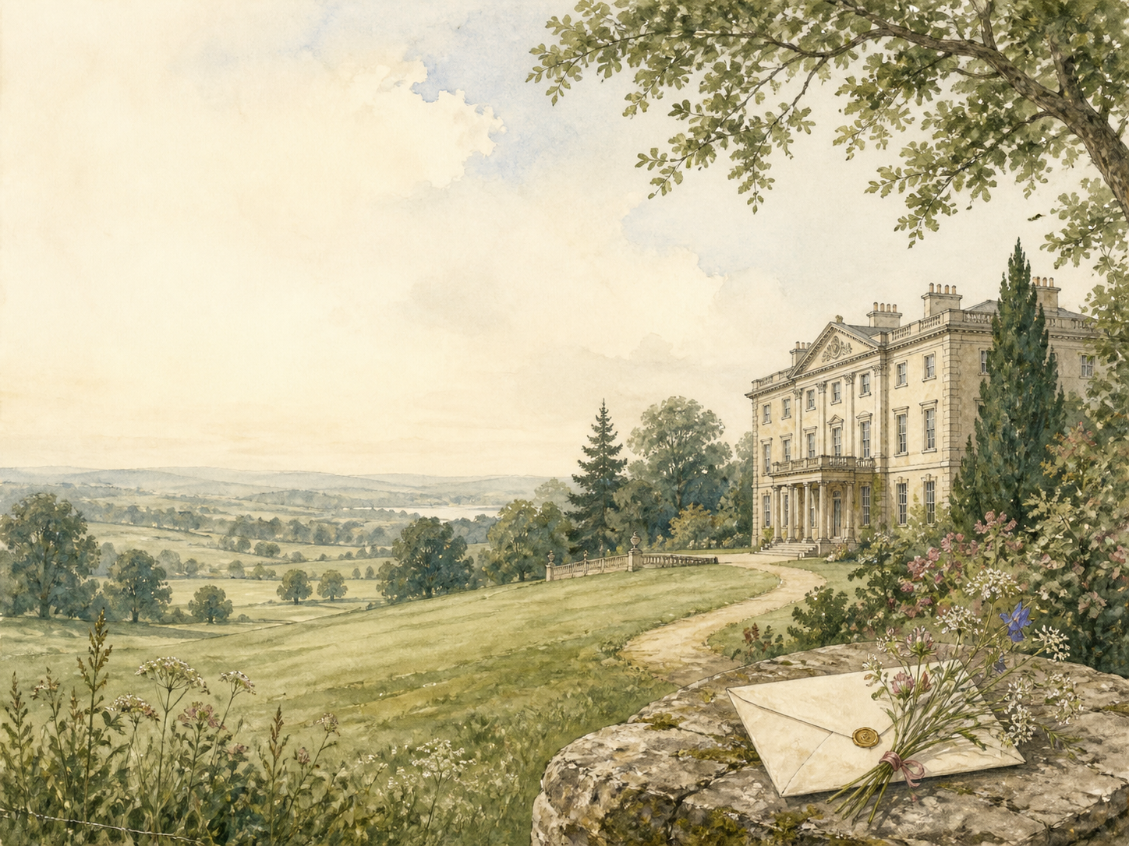
PRIDE AND PREJUDICE
Independent Living Book Study

Slide 2
Symbol Meanings
Reading Journal
Access to the Internet
History Journal
Pride and Prejudice Novel
Book of Centuries
Art Journal
First Impressions Tracker
Geography / Map

Slide 3
Day 1 Tasks
DAY 01 / 20
What do I need today?
Read Ch 1-3: The Ball at Meryton
Narration: Bingley arrives; Darcy's snub
Literacy: the famous opening line
Colour in the box when completed

Slide 4
Day 2 Tasks
DAY 02 / 20
What do I need today?
Read Ch 4-6: First Impressions
Discuss: the families size each other up
Discuss: what draws Darcy to Elizabeth
Colour in the box when completed

Slide 5
Day 3 Tasks
DAY 03 / 20
What do I need today?
Read Ch 7-9: Netherfield
Narration: Elizabeth's muddy walk
History: what was 'proper' for women
Colour in the box when completed

Slide 6
Day 4 Tasks
DAY 04 / 20
What do I need today?
Read Ch 10-12: Sparring
Discuss: who wins the battle of wits?
Literacy: character through dialogue
Colour in the box when completed

Slide 7
Day 5 Tasks
DAY 05 / 20
What do I need today?
Read Ch 13-15: Collins and Wickham
Narration: two new arrivals
Discuss: first impressions of each
Colour in the box when completed

Slide 8
Day 6 Tasks
DAY 06 / 20
What do I need today?
Read Ch 16-18: Wickham's Story
Discuss: do you believe Wickham?
Narration: the Netherfield ball
Colour in the box when completed

Slide 9
Day 7 Tasks
DAY 07 / 20
What do I need today?
Read Ch 19-21: A Refusal
Narration: Collins's proposal, refused
PSHE: refusing a loveless match
Colour in the box when completed

Slide 10
Day 8 Tasks
DAY 08 / 20
What do I need today?
Read Ch 22-24: Charlotte's Choice
Discuss: wise, or settling?
Maths: why marriage mattered financially
Colour in the box when completed

Slide 11
Day 9 Tasks
DAY 09 / 20
What do I need today?
Read Ch 25-27: To Kent
Narration: the Gardiners; the journey
Geography: map the route to Kent
Colour in the box when completed

Slide 12
Day 10 Tasks
DAY 10 / 20
What do I need today?
Read Ch 28-30: Rosings
Discuss: Lady Catherine's pride
Discuss: her pride vs Darcy's
Colour in the box when completed

Slide 13
Day 11 Tasks
DAY 11 / 20
What do I need today?
Read Ch 31-33: Darcy Returns
Discuss: what is happening to Darcy?
Literacy: feeling vs what Elizabeth sees
Colour in the box when completed

Slide 14
Day 12 Tasks
DAY 12 / 20
What do I need today?
Read Ch 34-36: Proposal and Letter
Narration: the proud proposal, refused
Discuss: the letter changes everything
Colour in the box when completed

Slide 15
Day 13 Tasks
DAY 13 / 20
What do I need today?
Read Ch 37-39: Second Thoughts
Discuss: what Elizabeth learns
PSHE: admitting you misjudged
Colour in the box when completed

Slide 16
Day 14 Tasks
DAY 14 / 20
What do I need today?
Read Ch 40-42: Toward Derbyshire
Narration: confiding in Jane; heading north
Geography: the Derbyshire estates
Colour in the box when completed

Slide 17
Day 15 Tasks
DAY 15 / 20
What do I need today?
Read Ch 43-45: Pemberley
Discuss: Pemberley changes her view
Art: illustrate Pemberley
Colour in the box when completed

Slide 18
Day 16 Tasks
DAY 16 / 20
What do I need today?
Read Ch 46-48: Scandal
Narration: Lydia's elopement
PSHE: reputation and family
Colour in the box when completed

Slide 19
Day 17 Tasks
DAY 17 / 20
What do I need today?
Read Ch 49-51: Patched Up
Discuss: who quietly paid to help?
Narration: Lydia and Wickham visit
Colour in the box when completed

Slide 20
Day 18 Tasks
DAY 18 / 20
What do I need today?
Read Ch 52-54: The Truth About Darcy
Discuss: Darcy's secret kindness
Literacy: how far Elizabeth has come
Colour in the box when completed

Slide 21
Day 19 Tasks
DAY 19 / 20
What do I need today?
Read Ch 55-57: Two Proposals Loom
Narration: Bingley; Lady Catherine
Discuss: why the bullying backfires
Colour in the box when completed

Slide 22
Day 20 Tasks
DAY 20 / 20
What do I need today?
Read Ch 58-61: Overcome
Wrap-up: how both have grown
Extension: whose pride, whose prejudice?
Colour in the box when completed

