Slide 1
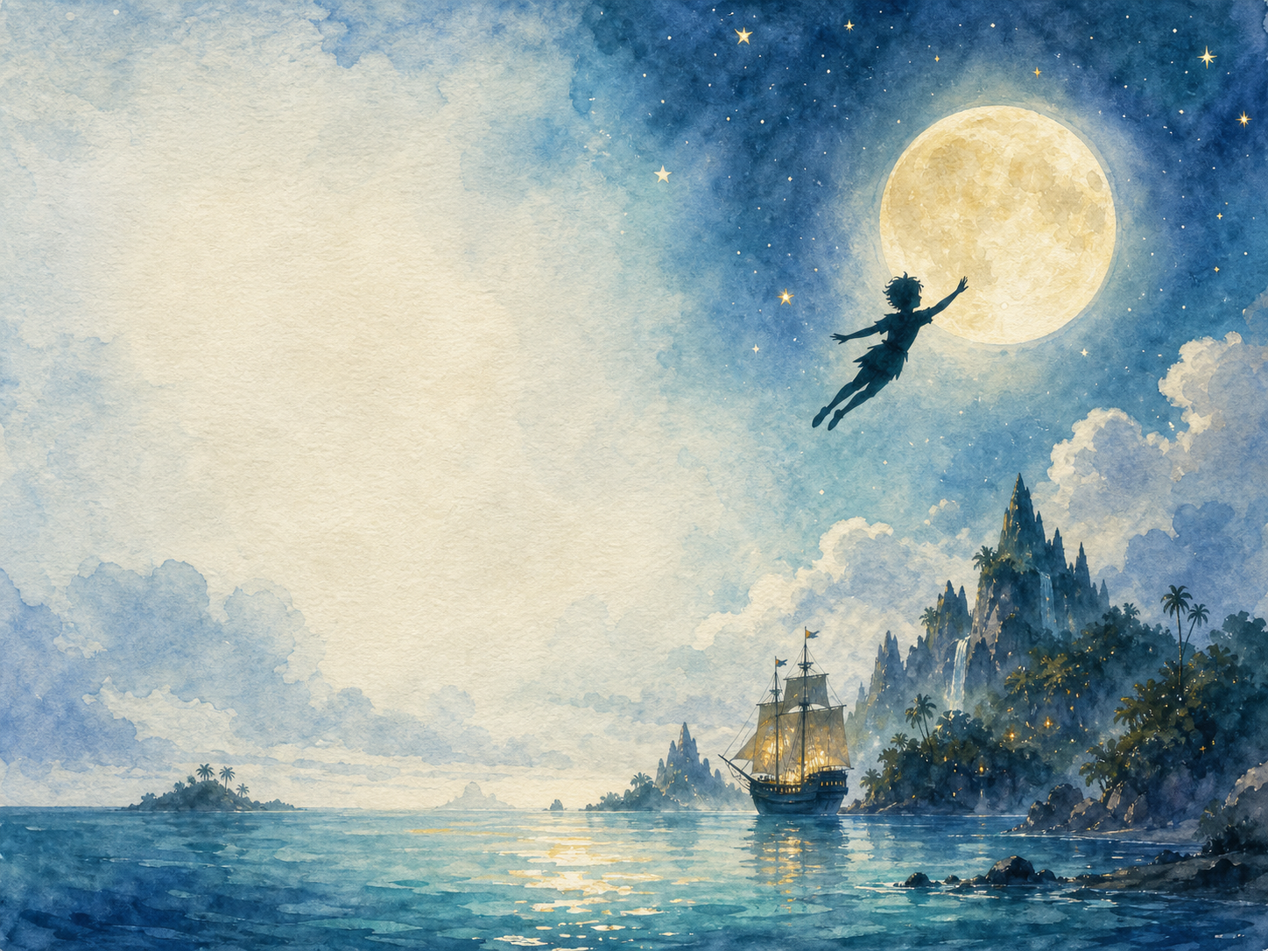
PETER PAN
Independent Living Book Study

Slide 2
Symbol Meanings
Writing Journal
Access to the Internet
History Journal
Peter Pan Novel
Book of Centuries
Art Journal
Character Profiles

Slide 3
Day 1 Tasks
DAY 01 / 17
What do I need today?
Read Ch 1: Peter Breaks Through
Narration: the Darling family
Discuss: the narrator talks to the reader
Colour in the box when completed

Slide 4
Day 2 Tasks
DAY 02 / 17
What do I need today?
Read Ch 2: The Shadow
Science: how shadows are made
Art: make shadow puppets
Colour in the box when completed

Slide 5
Day 3 Tasks
DAY 03 / 17
What do I need today?
Read Ch 3: Come Away, Come Away!
Discuss: why the children want to leave
Writing: would you have gone with Peter?
Colour in the box when completed

Slide 6
Day 4 Tasks
DAY 04 / 17
What do I need today?
Read Ch 4: The Flight
Geography: map the route to Neverland
Art: illustrate the flight
Colour in the box when completed

Slide 7
Day 5 Tasks
DAY 05 / 17
What do I need today?
Read Ch 5: The Island Come True
Discuss: who lives on Neverland?
History/PSHE: the 'tribe' portrayal, and changing attitudes
Colour in the box when completed

Slide 8
Day 6 Tasks
DAY 06 / 17
What do I need today?
Read Ch 6: The Little House
Discuss: why build Wendy a tiny house?
DT/Art: design a Wendy house
Colour in the box when completed

Slide 9
Day 7 Tasks
DAY 07 / 17
What do I need today?
Read Ch 7: The Home Under the Ground
Art: draw the underground home
Discuss: living there - like or dislike?
Colour in the box when completed

Slide 10
Day 8 Tasks
DAY 08 / 17
What do I need today?
Read Ch 8: The Mermaids' Lagoon
Narration: danger and beauty of the lagoon
Discuss: how the mermaids are portrayed
Colour in the box when completed

Slide 11
Day 9 Tasks
DAY 09 / 17
What do I need today?
Read Ch 9: The Never Bird
Discuss: Peter's cleverness
Writing: retell Peter's escape
Colour in the box when completed

Slide 12
Day 10 Tasks
DAY 10 / 17
What do I need today?
Read Ch 10: The Happy Home
PSHE: Wendy as 'mother'
Discuss: family roles, then and now
Colour in the box when completed

Slide 13
Day 11 Tasks
DAY 11 / 17
What do I need today?
Read Ch 11: Wendy's Story
Discuss: how the story affects the boys
Writing: write Wendy's story
Colour in the box when completed

Slide 14
Day 12 Tasks
DAY 12 / 17
What do I need today?
Read Ch 12: The Children Are Carried Off
Drama: act out the ambush
Narration: retell as a newspaper report
Colour in the box when completed

Slide 15
Day 13 Tasks
DAY 13 / 17
What do I need today?
Read Ch 13: Do You Believe in Fairies?
Discuss: the direct appeal to the reader
Extension: research how it's staged
Colour in the box when completed

Slide 16
Day 14 Tasks
DAY 14 / 17
What do I need today?
Read Ch 14: The Pirate Ship
Art: design a pirate ship
Discuss: how tension is built
Colour in the box when completed

Slide 17
Day 15 Tasks
DAY 15 / 17
What do I need today?
Read Ch 15: 'Hook or Me This Time'
Drama: perform the duel
Discuss: what makes Hook memorable
Colour in the box when completed

Slide 18
Day 16 Tasks
DAY 16 / 17
What do I need today?
Read Ch 16: The Return Home
Narration: the parents' reaction
Discuss: how the parents felt while waiting
Colour in the box when completed

Slide 19
Day 17 Tasks
DAY 17 / 17
What do I need today?
Read Ch 17: When Wendy Grew Up
Discuss: the bittersweet ending
Wrap-up: Peter vs. Wendy's choices
Colour in the box when completed

