Slide 1
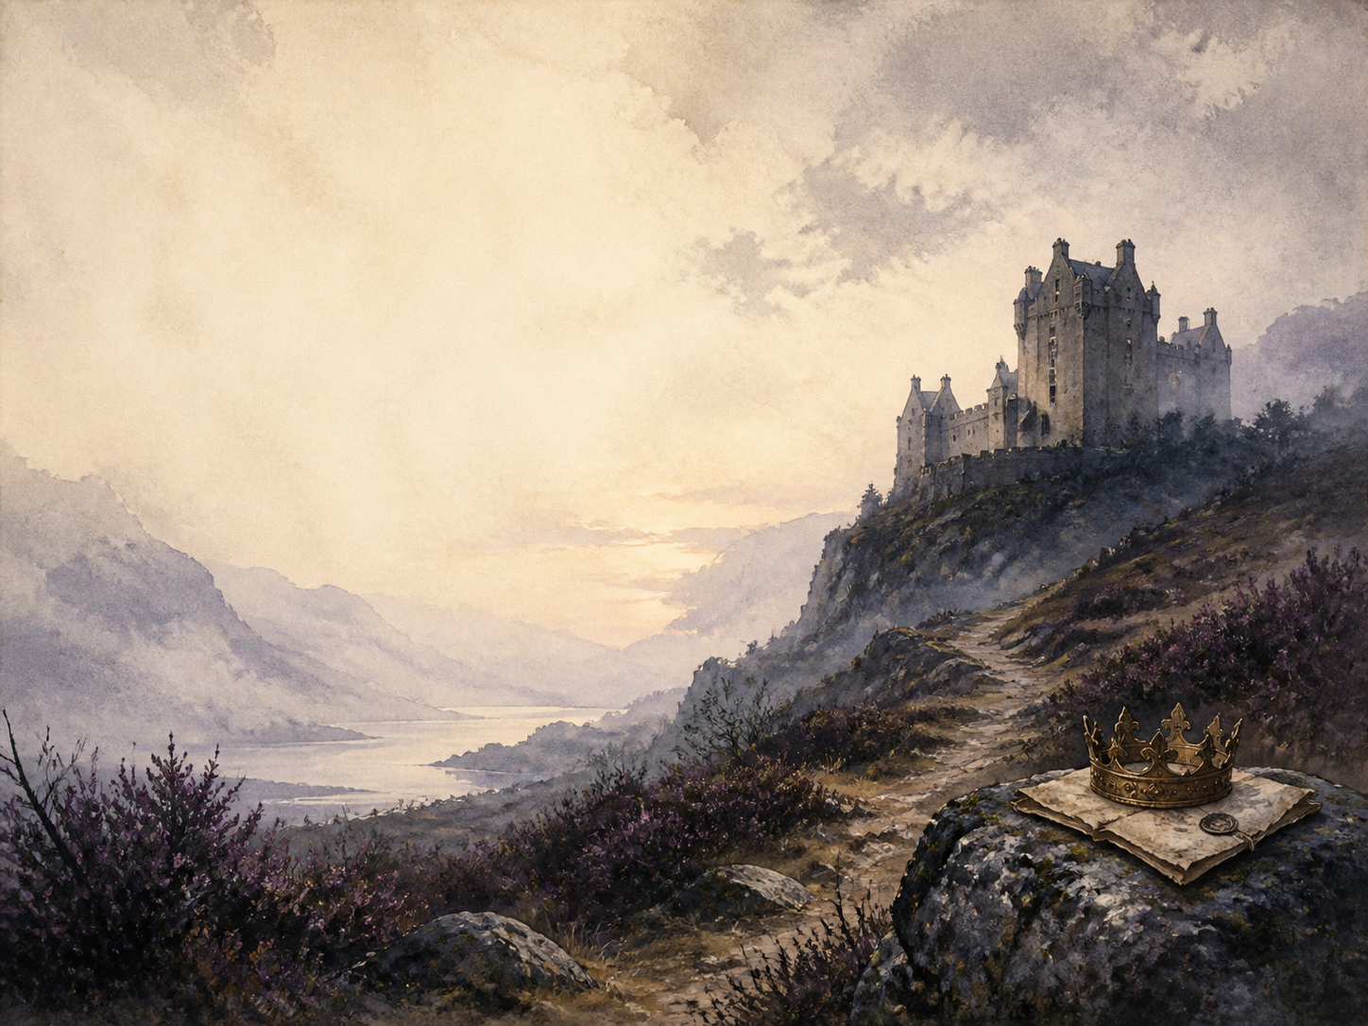
MACBETH
Independent Study - GCSE

Slide 2
Symbol Meanings
Reading Journal
Access to the Internet
History / Context Journal
The Play (Macbeth)
Book of Centuries
Art Journal
Quotation Bank
Watch a Production

Slide 3
Day 1
DAY 01 / 14
Read / watch this scene:
Read Act 1 Sc 1-3
Narration: the prophecies
Literacy: 'fair is foul'
Colour in the box when completed

Slide 4
Day 2
DAY 02 / 14
Read / watch this scene:
Read Act 1 Sc 4-5
Discuss: 'unsex me here'
History: Divine Right of Kings
Colour in the box when completed

Slide 5
Day 3
DAY 03 / 14
Read / watch this scene:
Read Act 1 Sc 6-7
Discuss: she changes his mind
Drama: the manhood taunt
Colour in the box when completed

Slide 6
Day 4
DAY 04 / 14
Read / watch this scene:
Read Act 2 Sc 1-2
Narration: dagger and murder
Literacy: the dagger speech
Colour in the box when completed

Slide 7
Day 5
DAY 05 / 14
Read / watch this scene:
Read Act 2 Sc 3-4
Discuss: why the Porter here?
History: equivocation
Colour in the box when completed

Slide 8
Day 6
DAY 06 / 14
Read / watch this scene:
Read Act 3 Sc 1-3
Discuss: Macbeth now gives orders
Literacy: how he has changed
Colour in the box when completed

Slide 9
Day 7
DAY 07 / 14
Read / watch this scene:
Read Act 3 Sc 4-6
Narration: Banquo's ghost
Drama: stage the ghost?
Colour in the box when completed

Slide 10
Day 8
DAY 08 / 14
Read / watch this scene:
Read Act 4 Sc 1
Discuss: the misleading prophecies
Literacy: dramatic irony
Colour in the box when completed

Slide 11
Day 9
DAY 09 / 14
Read / watch this scene:
Read Act 4 Sc 2
Narration: the Macduff murders
PSHE: how far he has fallen
Colour in the box when completed

Slide 12
Day 10
DAY 10 / 14
Read / watch this scene:
Read Act 4 Sc 3
Discuss: good king vs tyrant
Literacy: testing Macduff
Colour in the box when completed

Slide 13
Day 11
DAY 11 / 14
Read / watch this scene:
Read Act 5 Sc 1-3
Discuss: the roles reversed
Literacy: 'Out, damned spot'
Colour in the box when completed

Slide 14
Day 12
DAY 12 / 14
Read / watch this scene:
Read Act 5 Sc 4-6
Narration: Birnam Wood moves
Literacy: the 'Tomorrow' speech
Colour in the box when completed

Slide 15
Day 13
DAY 13 / 14
Read / watch this scene:
Read Act 5 Sc 7-8
Wrap-up: the prophecies fulfilled
Discuss: is order restored?
Colour in the box when completed

Slide 16
Day 14
DAY 14 / 14
Read / watch this scene:
Whole play - exam
Exam: plan a full essay
Extension: victim or villain?
Colour in the box when completed

