Slide 1
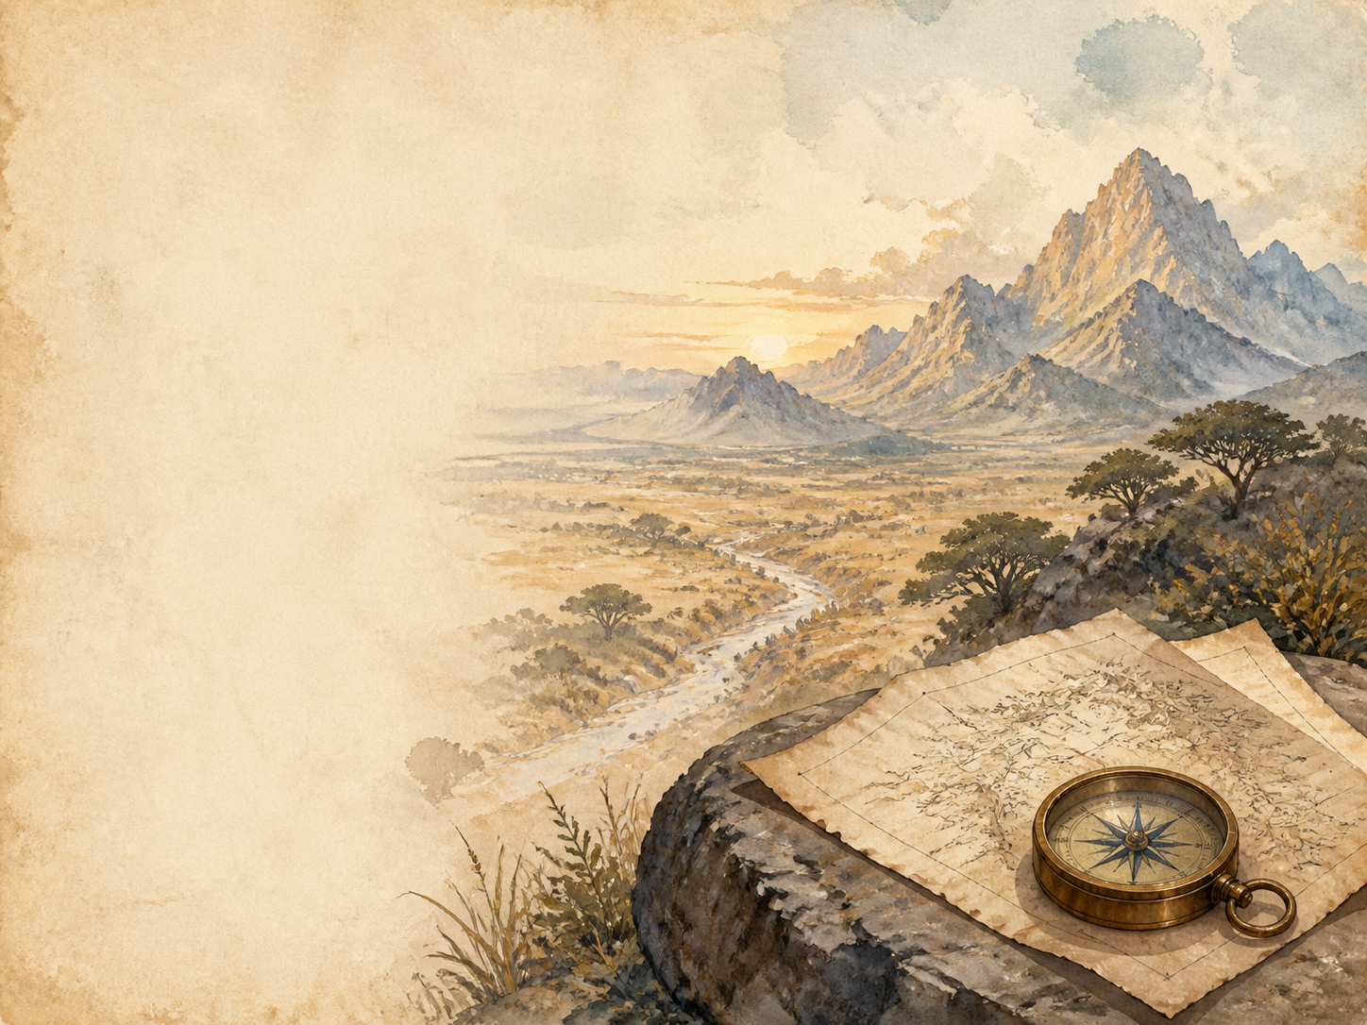
KING SOLOMON'S MINES
Independent Living Book Study

Slide 2
Symbol Meanings
Writing Journal
Access to the Internet
History Journal
King Solomon's Mines Novel
Book of Centuries
Art Journal
Explorer's Journal
Geography / Map

Slide 3
Day 1 Tasks
DAY 01 / 20
What do I need today?
Read Ch 1: I Meet Sir Henry Curtis
Narration: introduce the three main men
Discuss: why does Sir Henry want to go?
Colour in the box when completed

Slide 4
Day 2 Tasks
DAY 02 / 20
What do I need today?
Read Ch 2: The Legend of Solomon's Mines
History: legends of Solomon's lost riches
Art: draw da Silvestra's blood-drawn map
Colour in the box when completed

Slide 5
Day 3 Tasks
DAY 03 / 20
What do I need today?
Read Ch 3: Umbopa Enters Our Service
Discuss: what makes Umbopa stand out?
Predict: who might Umbopa really be?
Colour in the box when completed

Slide 6
Day 4 Tasks
DAY 04 / 20
What do I need today?
Read Ch 4: An Elephant Hunt
Science: African elephants and big-game hunting
Discuss: hunting then vs conservation today
Colour in the box when completed

Slide 7
Day 5 Tasks
DAY 05 / 20
What do I need today?
Read Ch 5: Our March into the Desert
Geography: map the route so far
Science: how the body copes without water
Colour in the box when completed

Slide 8
Day 6 Tasks
DAY 06 / 20
What do I need today?
Read Ch 6: Water! Water!
Narration: the desperate search for water
Science: how people survive in deserts
Colour in the box when completed

Slide 9
Day 7 Tasks
DAY 07 / 20
What do I need today?
Read Ch 7: Solomon's Road
History: ancient roads and who built them
Discuss: the mystery of the great road
Colour in the box when completed

Slide 10
Day 8 Tasks
DAY 08 / 20
What do I need today?
Read Ch 8: We Enter Kukuanaland
Geography: crossing Sheba's Breasts
Discuss: the 'men from the stars' belief
Colour in the box when completed

Slide 11
Day 9 Tasks
DAY 09 / 20
What do I need today?
Read Ch 9: Twala the King
Narration: describe Twala's court at Loo
Discuss: what makes Twala a tyrant?
Colour in the box when completed

Slide 12
Day 10 Tasks
DAY 10 / 20
What do I need today?
Read Ch 10: The Witch-Hunt
Discuss: Gagool and the 'smelling out'
History/PSHE: real witch-hunts and fear
Colour in the box when completed

Slide 13
Day 11 Tasks
DAY 11 / 20
What do I need today?
Read Ch 11: We Give a Sign
Science: how eclipses can be predicted
Discuss: Umbopa revealed as Ignosi
Colour in the box when completed

Slide 14
Day 12 Tasks
DAY 12 / 20
What do I need today?
Read Ch 12: Before the Battle
History: the Zulu impis behind the Kukuanas
Narration: how the two sides line up
Colour in the box when completed

Slide 15
Day 13 Tasks
DAY 13 / 20
What do I need today?
Read Ch 13: The Attack
Drama: act out a moment of the battle
Discuss: how Haggard pictures war
Colour in the box when completed

Slide 16
Day 14 Tasks
DAY 14 / 20
What do I need today?
Read Ch 14: The Last Stand of the Greys
Narration: retell the Greys' last stand
Discuss: courage and sacrifice
Colour in the box when completed

Slide 17
Day 15 Tasks
DAY 15 / 20
What do I need today?
Read Ch 15: Good Falls Sick
Discuss: Sir Henry vs Twala in single combat
PSHE: Foulata nurses Good back to health
Colour in the box when completed

Slide 18
Day 16 Tasks
DAY 16 / 20
What do I need today?
Read Ch 16: The Place of Death
Art: illustrate the seated stone kings
Discuss: how dread is built up
Colour in the box when completed

Slide 19
Day 17 Tasks
DAY 17 / 20
What do I need today?
Read Ch 17: Solomon's Treasure Chamber
Science: how diamonds form
Narration: describe the treasure chamber
Colour in the box when completed

Slide 20
Day 18 Tasks
DAY 18 / 20
What do I need today?
Read Ch 18: We Abandon Hope
Discuss: Gagool's betrayal, Foulata's death
Writing: trapped in the dark with a fortune
Colour in the box when completed

Slide 21
Day 19 Tasks
DAY 19 / 20
What do I need today?
Read Ch 19: Ignosi's Farewell
Discuss: Ignosi's new laws as king
PSHE: what makes a good ruler?
Colour in the box when completed

Slide 22
Day 20 Tasks
DAY 20 / 20
What do I need today?
Read Ch 20: Found
Wrap-up: what has the journey been about?
Extension: how does the book picture Africa?
Colour in the box when completed

