Slide 1
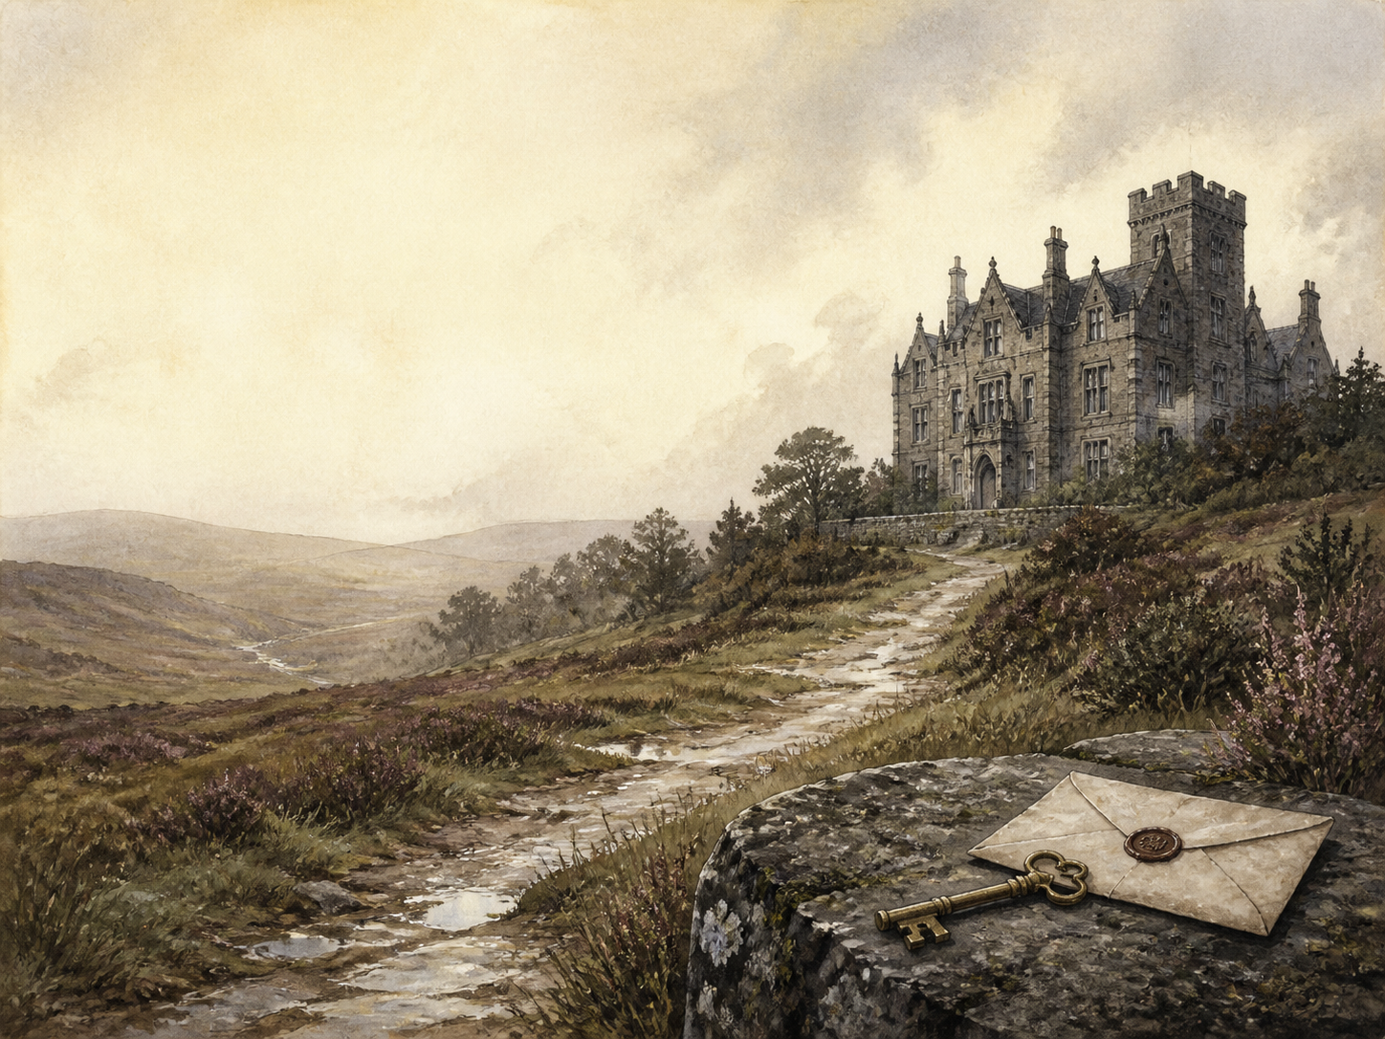
JANE EYRE
Independent Living Book Study

Slide 2
Symbol Meanings
Reading Journal
Access to the Internet
History Journal
Jane Eyre Novel
Book of Centuries
Art Journal
Setting / Mood Notes
Geography / Map

Slide 3
Day 1 Tasks
DAY 01 / 19
What do I need today?
Read Ch 1-2: Gateshead
Narration: Jane and the red-room
Discuss: what Jane's spirit shows
Colour in the box when completed

Slide 4
Day 2 Tasks
DAY 02 / 19
What do I need today?
Read Ch 3-4: Sent Away
Discuss: is Jane too bold?
History: Victorian charity schools
Colour in the box when completed

Slide 5
Day 3 Tasks
DAY 03 / 19
What do I need today?
Read Ch 5-6: Lowood
Narration: Lowood and Helen Burns
PSHE: patience vs fighting back
Colour in the box when completed

Slide 6
Day 4 Tasks
DAY 04 / 19
What do I need today?
Read Ch 7-8: Judged and Cleared
Discuss: adults and their power
Literacy: cruel vs kind figures
Colour in the box when completed

Slide 7
Day 5 Tasks
DAY 05 / 19
What do I need today?
Read Ch 9-10: Loss and Growth
Narration: Helen's death; leaving Lowood
Discuss: how Jane has changed
Colour in the box when completed

Slide 8
Day 6 Tasks
DAY 06 / 19
What do I need today?
Read Ch 11-12: Thornfield
Narration: arrival; meeting Rochester
Geography: the moor and the laughter
Colour in the box when completed

Slide 9
Day 7 Tasks
DAY 07 / 19
What do I need today?
Read Ch 13-14: Sparring
Discuss: what draws them together
Literacy: Rochester's appeal and unease
Colour in the box when completed

Slide 10
Day 8 Tasks
DAY 08 / 19
What do I need today?
Read Ch 15-16: Fire in the Night
Narration: Jane saves Rochester
Discuss: what the fire hints at
Colour in the box when completed

Slide 11
Day 9 Tasks
DAY 09 / 19
What do I need today?
Read Ch 17-18: Blanche Ingram
Discuss: Jane's hidden feelings
History: the marriage market
Colour in the box when completed

Slide 12
Day 10 Tasks
DAY 10 / 19
What do I need today?
Read Ch 19-20: Deepening Mystery
Narration: fortune-teller; the attack
Discuss: the clues being planted
Colour in the box when completed

Slide 13
Day 11 Tasks
DAY 11 / 19
What do I need today?
Read Ch 21-22: Return to Gateshead
Discuss: can Jane forgive her aunt?
PSHE: forgiveness earned or given
Colour in the box when completed

Slide 14
Day 12 Tasks
DAY 12 / 19
What do I need today?
Read Ch 23-24: The Proposal
Narration: the chestnut-tree proposal
Literacy: the split tree as omen
Colour in the box when completed

Slide 15
Day 13 Tasks
DAY 13 / 19
What do I need today?
Read Ch 25-26: The Wedding Stopped
Narration: the secret revealed
Discuss: delivering the shock
Colour in the box when completed

Slide 16
Day 14 Tasks
DAY 14 / 19
What do I need today?
Read Ch 27-28: Flight
Discuss: why Jane will not stay
RE/PSHE: conscience and its cost
Colour in the box when completed

Slide 17
Day 15 Tasks
DAY 15 / 19
What do I need today?
Read Ch 29-30: Moor House
Narration: rescued by the Rivers
Discuss: kindness begins to heal
Colour in the box when completed

Slide 18
Day 16 Tasks
DAY 16 / 19
What do I need today?
Read Ch 31-32: The Schoolmistress
Discuss: St John's cold goodness
Literacy: St John vs Rochester
Colour in the box when completed

Slide 19
Day 17 Tasks
DAY 17 / 19
What do I need today?
Read Ch 33-34: An Inheritance
Narration: fortune and cousins
PSHE: sharing the money equally
Colour in the box when completed

Slide 20
Day 18 Tasks
DAY 18 / 19
What do I need today?
Read Ch 35-36: The Call
Discuss: refusing St John
Literacy: the supernatural 'call'
Colour in the box when completed

Slide 21
Day 19 Tasks
DAY 19 / 19
What do I need today?
Read Ch 37-38: Ferndean
Wrap-up: why she can marry him now
Extension: love AND independence
Colour in the box when completed

