Slide 1
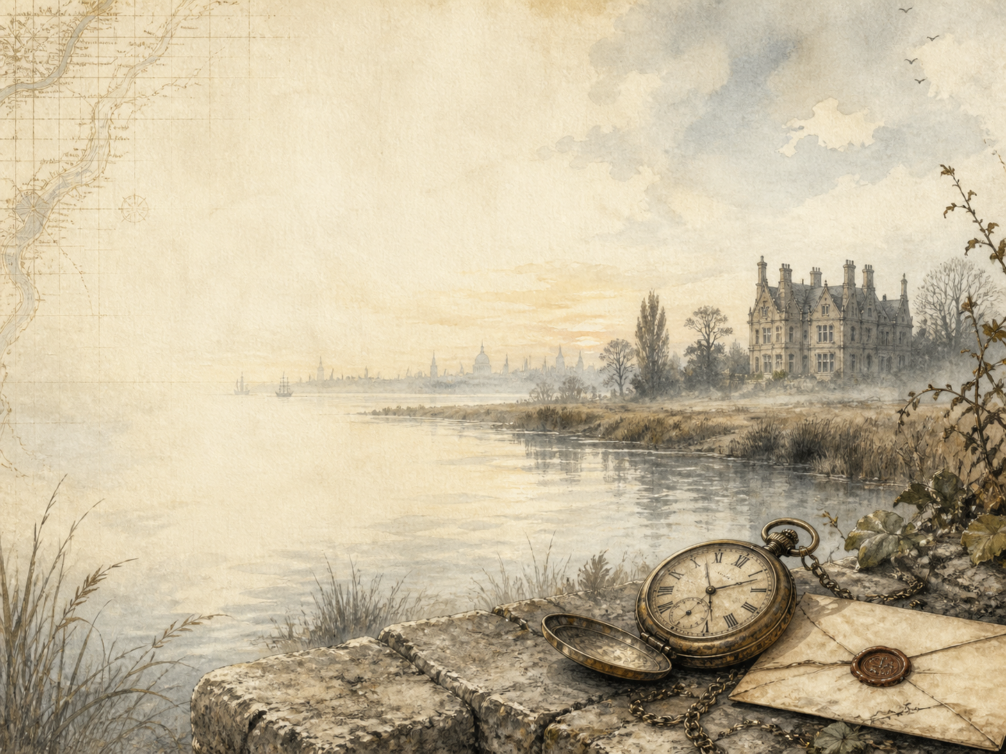
GREAT EXPECTATIONS
Independent Living Book Study

Slide 2
Symbol Meanings
Reading Journal
Access to the Internet
History Journal
Great Expectations Novel
Book of Centuries
Art Journal
Character Tracker
Geography / Map

Slide 3
Day 1 Tasks
DAY 01 / 20
What do I need today?
Read Ch 1-3: The Marshes
Narration: Pip meets the convict
Discuss: why does Pip help him?
Colour in the box when completed

Slide 4
Day 2 Tasks
DAY 02 / 20
What do I need today?
Read Ch 4-6: Christmas and the Soldiers
Narration: dinner and the hunt
Discuss: why take the blame for the theft?
Colour in the box when completed

Slide 5
Day 3 Tasks
DAY 03 / 20
What do I need today?
Read Ch 7-9: Satis House
Art: draw the stopped-clock room
Discuss: why does 'common' wound Pip?
Colour in the box when completed

Slide 6
Day 4 Tasks
DAY 04 / 20
What do I need today?
Read Ch 10-12: A Change in Pip
Discuss: how Estella changes Pip
History: life for a poor Victorian family
Colour in the box when completed

Slide 7
Day 5 Tasks
DAY 05 / 20
What do I need today?
Read Ch 13-15: The Forge
Discuss: is Pip fair to Joe?
Science/DT: the blacksmith's work
Colour in the box when completed

Slide 8
Day 6 Tasks
DAY 06 / 20
What do I need today?
Read Ch 16-18: Great Expectations
Narration: Pip's sudden fortune
Discuss: who does Pip assume his patron is?
Colour in the box when completed

Slide 9
Day 7 Tasks
DAY 07 / 20
What do I need today?
Read Ch 19-21: To London
Narration: leaving home for the city
Geography: map Pip's journey
Colour in the box when completed

Slide 10
Day 8 Tasks
DAY 08 / 20
What do I need today?
Read Ch 22-24: A New Life
Discuss: Herbert Pocket vs Pip
History: being a 'gentleman'
Colour in the box when completed

Slide 11
Day 9 Tasks
DAY 09 / 20
What do I need today?
Read Ch 25-27: Joe's Visit
Discuss: Pip's embarrassment at Joe
Writing: Joe's private thoughts
Colour in the box when completed

Slide 12
Day 10 Tasks
DAY 10 / 20
What do I need today?
Read Ch 28-30: Home Again
Discuss: how has Pip changed?
Discuss: Estella's effect on Pip
Colour in the box when completed

Slide 13
Day 11 Tasks
DAY 11 / 20
What do I need today?
Read Ch 31-33: London and Estella
Discuss: Pip and Estella's bond
Art: illustrate London life
Colour in the box when completed

Slide 14
Day 12 Tasks
DAY 12 / 20
What do I need today?
Read Ch 34-36: Debt and Coming of Age
Discuss: money and status
PSHE: living beyond your means
Colour in the box when completed

Slide 15
Day 13 Tasks
DAY 13 / 20
What do I need today?
Read Ch 37-39: The Benefactor Returns
Narration: Magwitch's return
Discuss: the shock to Pip's dreams
Colour in the box when completed

Slide 16
Day 14 Tasks
DAY 14 / 20
What do I need today?
Read Ch 40-42: Magwitch's Story
Narration: retell his life
History: hulks and transportation
Colour in the box when completed

Slide 17
Day 15 Tasks
DAY 15 / 20
What do I need today?
Read Ch 43-45: Danger
Discuss: why Estella chooses Drummle
Discuss: the changing mood
Colour in the box when completed

Slide 18
Day 16 Tasks
DAY 16 / 20
What do I need today?
Read Ch 46-48: The Plan
Narration: the plan to save Magwitch
Discuss: Pip's changing feelings
Colour in the box when completed

Slide 19
Day 17 Tasks
DAY 17 / 20
What do I need today?
Read Ch 49-51: Fire and Secrets
Discuss: Miss Havisham's remorse
Discuss: the secret of Estella's parents
Colour in the box when completed

Slide 20
Day 18 Tasks
DAY 18 / 20
What do I need today?
Read Ch 52-54: The River
Drama: Orlick's trap
Narration: the river escape
Colour in the box when completed

Slide 21
Day 19 Tasks
DAY 19 / 20
What do I need today?
Read Ch 55-57: Loss and Kindness
Discuss: Pip's view of Magwitch now
PSHE: Joe's quiet goodness
Colour in the box when completed

Slide 22
Day 20 Tasks
DAY 20 / 20
What do I need today?
Read Ch 58-59: The Reckoning
Wrap-up: what makes a 'gentleman'?
Extension: Dickens' two endings
Colour in the box when completed

