Slide 1
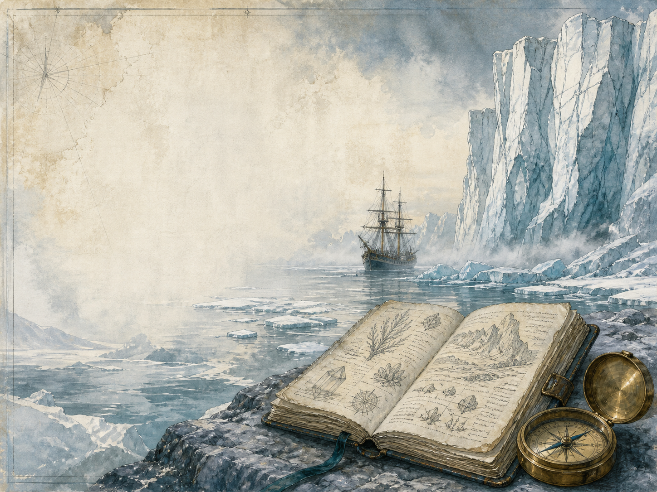
FRANKENSTEIN
Independent Living Book Study

Slide 2
Symbol Meanings
Reading Journal
Access to the Internet
History Journal
Frankenstein Novel
Book of Centuries
Art Journal
Science / Ethics Notes
Geography / Map

Slide 3
Day 1 Tasks
DAY 01 / 14
What do I need today?
Read Walton's Letters 1-4
Narration: who is Walton?
Discuss: the effect of the 'frame'
Colour in the box when completed

Slide 4
Day 2 Tasks
DAY 02 / 14
What do I need today?
Read Ch 1-2: Geneva
Narration: Victor's childhood
History: the Romantic age
Colour in the box when completed

Slide 5
Day 3 Tasks
DAY 03 / 14
What do I need today?
Read Ch 3-4: Ingolstadt
Discuss: is his ambition dangerous?
Science: galvanism and electricity
Colour in the box when completed

Slide 6
Day 4 Tasks
DAY 04 / 14
What do I need today?
Read Ch 5: The Creation
Narration: the creature awakes
Discuss: what did Victor owe it?
Colour in the box when completed

Slide 7
Day 5 Tasks
DAY 05 / 14
What do I need today?
Read Ch 6-7: Bad News
Narration: William is murdered
Discuss: dread gathers
Colour in the box when completed

Slide 8
Day 6 Tasks
DAY 06 / 14
What do I need today?
Read Ch 8: Justice Denied
Discuss: why Victor stays silent
PSHE: injustice and speaking up
Colour in the box when completed

Slide 9
Day 7 Tasks
DAY 07 / 14
What do I need today?
Read Ch 9-10: On the Glacier
Narration: creator meets creation
Art: illustrate the meeting on the ice
Colour in the box when completed

Slide 10
Day 8 Tasks
DAY 08 / 14
What do I need today?
Read Ch 11-12: The Creature Speaks
Narration: its first days
Discuss: hearing its own voice
Colour in the box when completed

Slide 11
Day 9 Tasks
DAY 09 / 14
What do I need today?
Read Ch 13-14: Learning
Discuss: what the creature longs for
Literacy: the creature's diary
Colour in the box when completed

Slide 12
Day 10 Tasks
DAY 10 / 14
What do I need today?
Read Ch 15-16: Rejected
Discuss: who is to blame?
PSHE: rejection and loneliness
Colour in the box when completed

Slide 13
Day 11 Tasks
DAY 11 / 14
What do I need today?
Read Ch 17-18: The Demand
Discuss: should Victor agree?
Geography: map his journey
Colour in the box when completed

Slide 14
Day 12 Tasks
DAY 12 / 14
What do I need today?
Read Ch 19-20: The Broken Promise
Narration: the creature's vow
Discuss: was Victor right?
Colour in the box when completed

Slide 15
Day 13 Tasks
DAY 13 / 14
What do I need today?
Read Ch 21-22: Revenge
Narration: the losses that follow
Discuss: building suspense
Colour in the box when completed

Slide 16
Day 14 Tasks
DAY 14 / 14
What do I need today?
Read Ch 23-24: The Arctic
Wrap-up: who do you pity most?
Extension: maker or made - the real monster?
Colour in the box when completed

