Slide 1
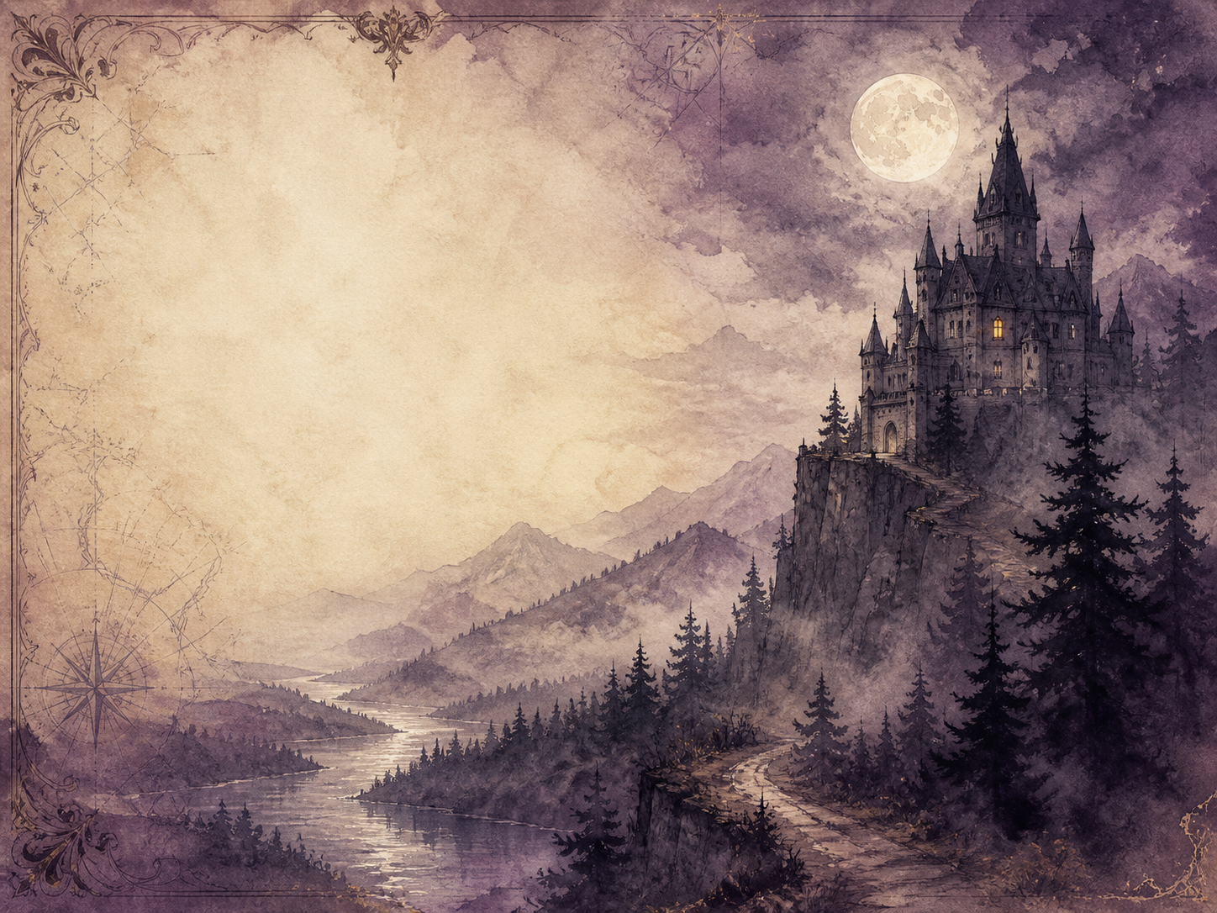
DRACULA
Independent Living Book Study

Slide 2
Symbol Meanings
Reading Journal
Access to the Internet
History Journal
Dracula Novel
Book of Centuries
Art Journal
Suspense Notes
Geography / Map

Slide 3
Day 1 Tasks
DAY 01 / 14
What do I need today?
Read Ch 1-2: Into the Mountains
Narration: the journey to the castle
Discuss: the early warning signs
Colour in the box when completed

Slide 4
Day 2 Tasks
DAY 02 / 14
What do I need today?
Read Ch 3-4: A Prisoner
Narration: Harker's escape attempt
Art: illustrate Castle Dracula
Colour in the box when completed

Slide 5
Day 3 Tasks
DAY 03 / 14
What do I need today?
Read Ch 5-6: England
Discuss: weaving the documents together
Geography: research Whitby
Colour in the box when completed

Slide 6
Day 4 Tasks
DAY 04 / 14
What do I need today?
Read Ch 7-8: The Ship
Narration: the ship's last log
Literacy: why the log is so chilling
Colour in the box when completed

Slide 7
Day 5 Tasks
DAY 05 / 14
What do I need today?
Read Ch 9-10: The Illness
Discuss: what baffles the doctors
Science: Victorian blood transfusion
Colour in the box when completed

Slide 8
Day 6 Tasks
DAY 06 / 14
What do I need today?
Read Ch 11-12: Loss
Narration: the events of Lucy's death
Discuss: building dread
Colour in the box when completed

Slide 9
Day 7 Tasks
DAY 07 / 14
What do I need today?
Read Ch 13-14: The Bloofer Lady
Discuss: Van Helsing's suspicion
PSHE: believing the impossible
Colour in the box when completed

Slide 10
Day 8 Tasks
DAY 08 / 14
What do I need today?
Read Ch 15-16: The Un-Dead
Discuss: why the scene is so solemn
Literacy: the narrators' voices
Colour in the box when completed

Slide 11
Day 9 Tasks
DAY 09 / 14
What do I need today?
Read Ch 17-18: The Hunters Unite
Narration: the plan comes together
History: the hunters' technology
Colour in the box when completed

Slide 12
Day 10 Tasks
DAY 10 / 14
What do I need today?
Read Ch 19-20: The Hunt Begins
Narration: spoiling the earth-boxes
Discuss: going on the attack
Colour in the box when completed

Slide 13
Day 11 Tasks
DAY 11 / 14
What do I need today?
Read Ch 21-22: Mina in Danger
Discuss: the friends' response
PSHE: courage under dread
Colour in the box when completed

Slide 14
Day 12 Tasks
DAY 12 / 14
What do I need today?
Read Ch 23-24: The Count Flees
Narration: picking up the trail
Geography: map the chase
Colour in the box when completed

Slide 15
Day 13 Tasks
DAY 13 / 14
What do I need today?
Read Ch 25-26: The Race
Discuss: winding up the tension
Science: what hypnosis really is
Colour in the box when completed

Slide 16
Day 14 Tasks
DAY 14 / 14
What do I need today?
Read Ch 27: The Reckoning
Wrap-up: was the ending satisfying?
Extension: the fears Dracula gives shape to
Colour in the box when completed

