Slide 1
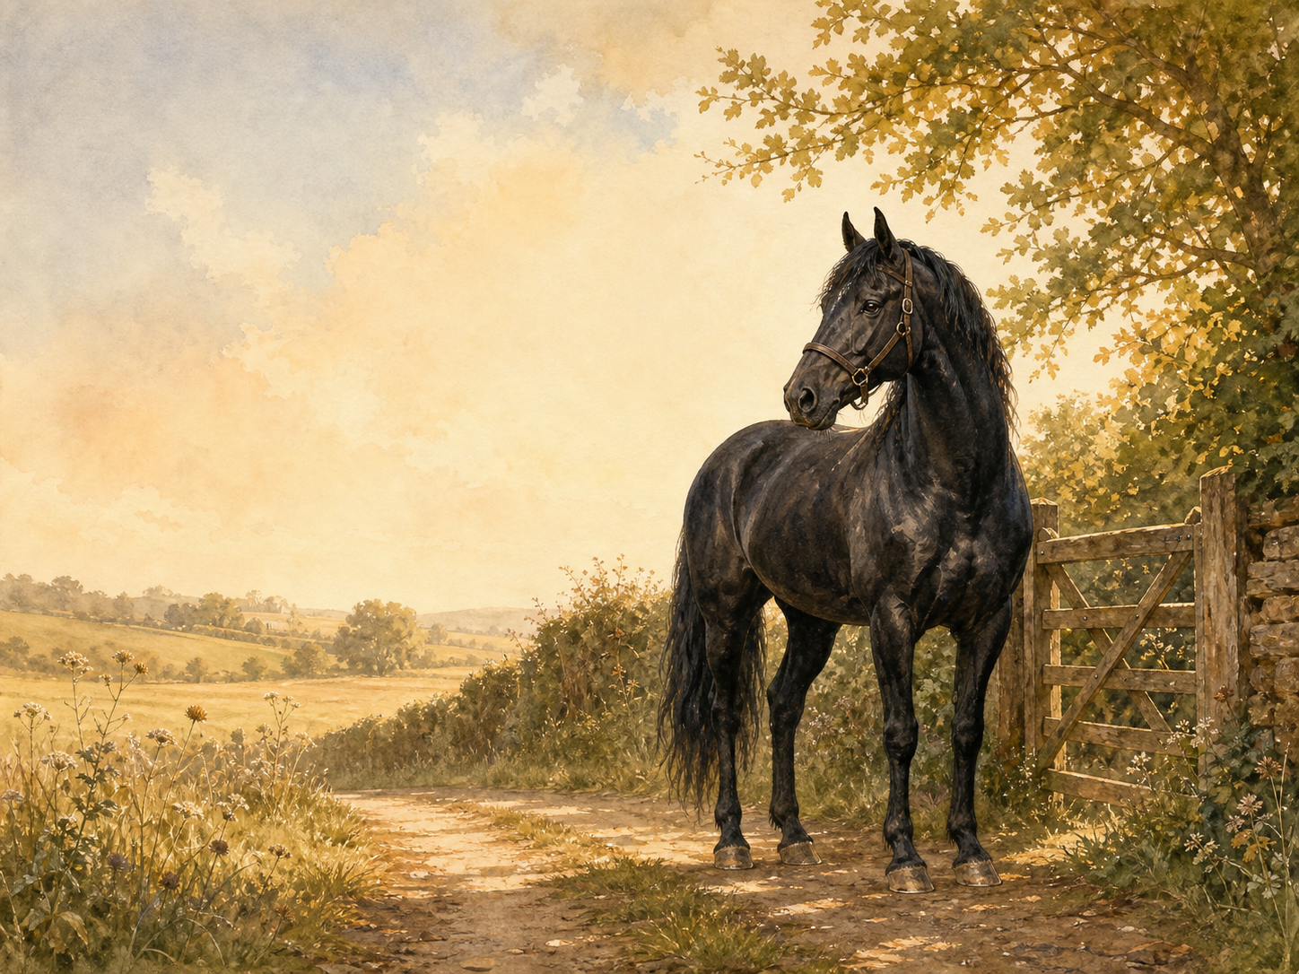
BLACK BEAUTY
Independent Living Book Study

Slide 2
Symbol Meanings
Writing Journal
Access to the Internet
History Journal
Black Beauty Novel
Book of Centuries
Art Journal
Horse Care Fact File

Slide 3
Day 1 Tasks
DAY 01 / 17
What do I need today?
Read Ch 1-3: My Early Home / The Hunt / Breaking In
Narration: values from Black Beauty's mother
Nature: training young horses today
Colour in the box when completed

Slide 4
Day 2 Tasks
DAY 02 / 17
What do I need today?
Read Ch 4-6: Birtwick Park / A Fair Start / Liberty
Discuss: what makes Birtwick Park a good home?
Art: draw Black Beauty's stable
Colour in the box when completed

Slide 5
Day 3 Tasks
DAY 03 / 17
What do I need today?
Read Ch 7-8: Ginger / Ginger's Story Continued
Narration: what shaped Ginger's temper?
Discuss: unkindness and bad behaviour
Colour in the box when completed

Slide 6
Day 4 Tasks
DAY 04 / 17
What do I need today?
Read Ch 9-10: Merrylegs / A Talk in the Orchard
Compare the three horses in a table
Discuss: which horse would you like to know?
Colour in the box when completed

Slide 7
Day 5 Tasks
DAY 05 / 17
What do I need today?
Read Ch 11-13: Plain Speaking / The Devil's Trade Mark
Discuss: John Manly on the bearing rein
History: research the bearing/check rein
Colour in the box when completed

Slide 8
Day 6 Tasks
DAY 06 / 17
What do I need today?
Read Ch 14-16: James Howard / The Fire
Narration: how tension builds in The Fire
Discuss: courage in the fire scene
Colour in the box when completed

Slide 9
Day 7 Tasks
DAY 07 / 17
What do I need today?
Read Ch 17-19: Going for the Doctor / Only Ignorance
Discuss: loyalty and intelligence
Writing: the doctor's point of view
Colour in the box when completed

Slide 10
Day 8 Tasks
DAY 08 / 17
What do I need today?
Read Ch 20-21: Joe Green / The Parting
Discuss: why the horses are sold
Writing: Black Beauty's feelings on leaving
Colour in the box when completed

Slide 11
Day 9 Tasks
DAY 09 / 17
What do I need today?
Read Ch 22-24: Earlshall / A Strike for Liberty
Discuss: life changes at Earlshall
Discuss: what Ginger's 'strike' shows us
Colour in the box when completed

Slide 12
Day 10 Tasks
DAY 10 / 17
What do I need today?
Read Ch 25-27: Reuben Smith / Ruined and Going Downhill
Narration: Reuben Smith's carelessness
Discuss: ruined through no fault of his own
Colour in the box when completed

Slide 13
Day 11 Tasks
DAY 11 / 17
What do I need today?
Read Ch 28-31: A Job Horse / A Thief / A Humbug
Discuss: different owners, different treatment
Geography: research Victorian horse fairs
Colour in the box when completed

Slide 14
Day 12 Tasks
DAY 12 / 17
What do I need today?
Read Ch 32-35: A Horse Fair / Jerry Barker
History: Victorian London cab life
Narration: what makes Jerry different?
Colour in the box when completed

Slide 15
Day 13 Tasks
DAY 13 / 17
What do I need today?
Read Ch 36-39: The Golden Rule / Seedy Sam
Discuss: the Golden Rule's meaning
Discuss: poverty and hardship in the book
Colour in the box when completed

Slide 16
Day 14 Tasks
DAY 14 / 17
What do I need today?
Read Ch 40-43: Poor Ginger / A Friend in Need
Narration: meeting Ginger again
PSHE: kindness to horses and to people
Colour in the box when completed

Slide 17
Day 15 Tasks
DAY 15 / 17
What do I need today?
Read Ch 44-45: Old Captain / Jerry's New Year
Discuss: how Jerry's family has fared
Writing: a New Year diary entry
Colour in the box when completed

Slide 18
Day 16 Tasks
DAY 16 / 17
What do I need today?
Read Ch 46-49: Farmer Thoroughgood / My Last Home
Narration: the journey to retirement
Discuss: why the book ends this way
Colour in the box when completed

Slide 19
Day 17 Tasks
DAY 17 / 17
What do I need today?
Response day - review the whole book
Write your own 'Kindness Code'
Wrap-up: compare treatment across the book
Colour in the box when completed

