Slide 1
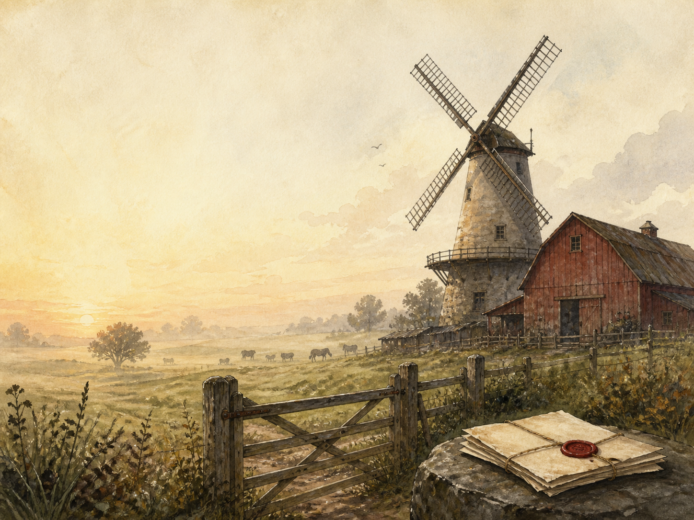
ANIMAL FARM
Independent Study - GCSE

Slide 2
Symbol Meanings
Reading Journal
Access to the Internet
History / Context Journal
Animal Farm Novel
Book of Centuries
Art Journal
Allegory Tracker
Commandments Tracker

Slide 3
Day 1 Tasks
DAY 01 / 10
What do I need today?
Read Ch 1: Old Major's Dream
Narration: the vision and the song
History: Marx and Lenin's ideas
Colour in the box when completed

Slide 4
Day 2 Tasks
DAY 02 / 10
What do I need today?
Read Ch 2: The Rebellion
Narration: Jones driven out; the Commandments
History: the 1917 Revolution
Colour in the box when completed

Slide 5
Day 3 Tasks
DAY 03 / 10
What do I need today?
Read Ch 3: The Harvest
Discuss: the milk and apples
PSHE: the first small betrayal
Colour in the box when completed

Slide 6
Day 4 Tasks
DAY 04 / 10
What do I need today?
Read Ch 4: Battle of the Cowshed
Narration: the farm defended
History: the Russian Civil War
Colour in the box when completed

Slide 7
Day 5 Tasks
DAY 05 / 10
What do I need today?
Read Ch 5: Snowball Driven Out
Discuss: how Napoleon seizes power
History: Trotsky vs Stalin
Colour in the box when completed

Slide 8
Day 6 Tasks
DAY 06 / 10
What do I need today?
Read Ch 6: The Windmill
Discuss: Squealer explains away the rules
History: Stalin's Five-Year Plans
Colour in the box when completed

Slide 9
Day 7 Tasks
DAY 07 / 10
What do I need today?
Read Ch 7: Confessions
Narration: the purges and executions
History: the Great Purge
Colour in the box when completed

Slide 10
Day 8 Tasks
DAY 08 / 10
What do I need today?
Read Ch 8: The Cult of Napoleon
Discuss: making a god of the leader
History: invasion and cult of Stalin
Colour in the box when completed

Slide 11
Day 9 Tasks
DAY 09 / 10
What do I need today?
Read Ch 9: Boxer's Fate
Discuss: why Boxer's fate matters most
PSHE: the betrayal of the loyal
Colour in the box when completed

Slide 12
Day 10 Tasks
DAY 10 / 10
What do I need today?
Read Ch 10: More Equal Than Others
Wrap-up: building to the final line
Extension: Orwell's warning
Colour in the box when completed

